Slide 1
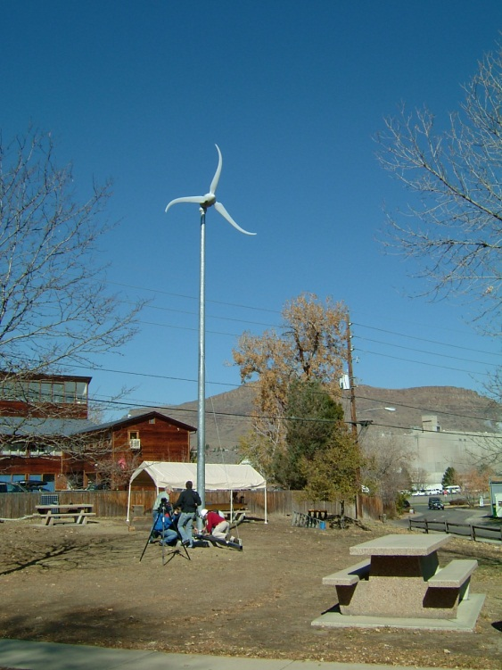
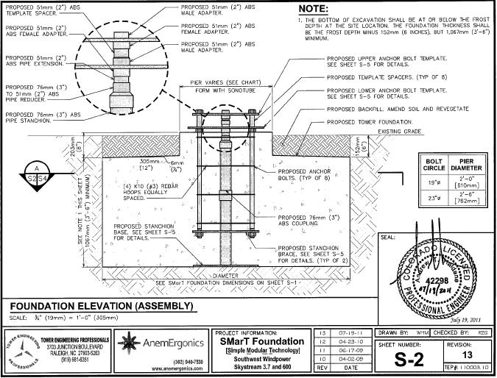
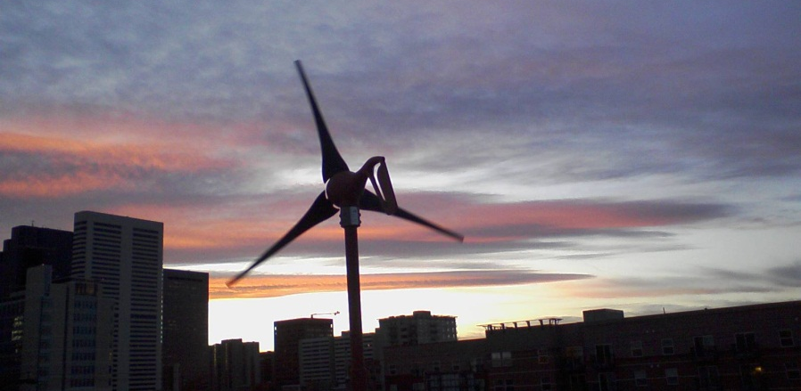
Small Wind
Foundation Challenges
January 13, 2015
Tim Olsen
Advanced Energy Systems, LLC
1428 South Humboldt Street
Denver, CO 80210
303-777-3341
www.windtechnology.com

Slide 2
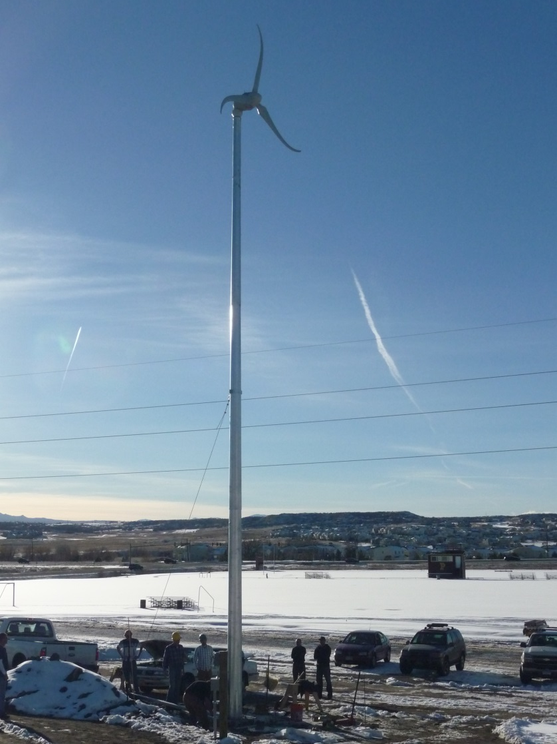
Small Wind
Foundation Challenges
A. Pricing Challenge
B. Cases:
Bean, Fort Lupton, CO
Thorne, Boulder, CO
Storage Masters, Denver, CO
Stratton HS, Stratton, CO

Slide 3
Small Wind
Foundation Challenges
Pricing Challenge:
1. Competition with Solar PV:
Solar PV: rapid decline from $10 to $3/W at 17% CF in CO
Wind, 200W-10kW: still holding at $7W+ at 20-35% CF

Slide 4
Small Wind
Foundation Challenges
Pricing Challenge:
Field Quotes:
Rating Ideal Realistic
2.5 kW $13,000 $18,000
10 kW $45,000 $70,000
Every case is custom!
Project management rate: ~$10/hr

Slide 5
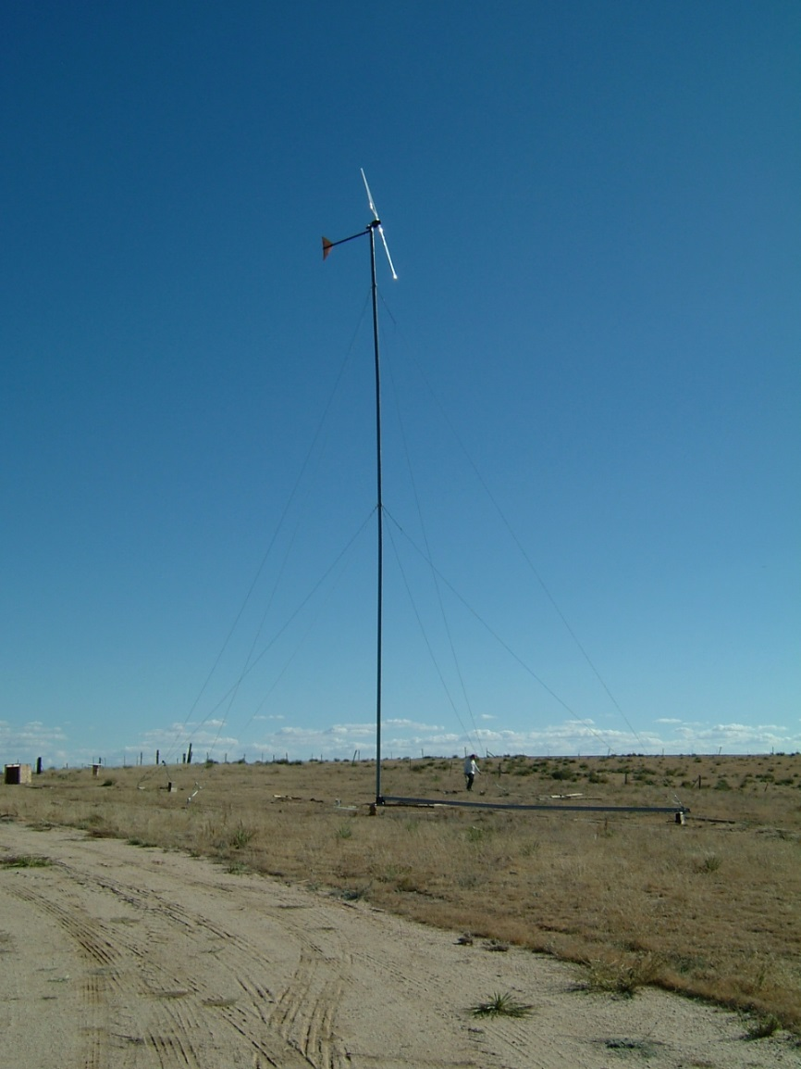
Small Wind
Foundation Challenges
B. Cases

Slide 6
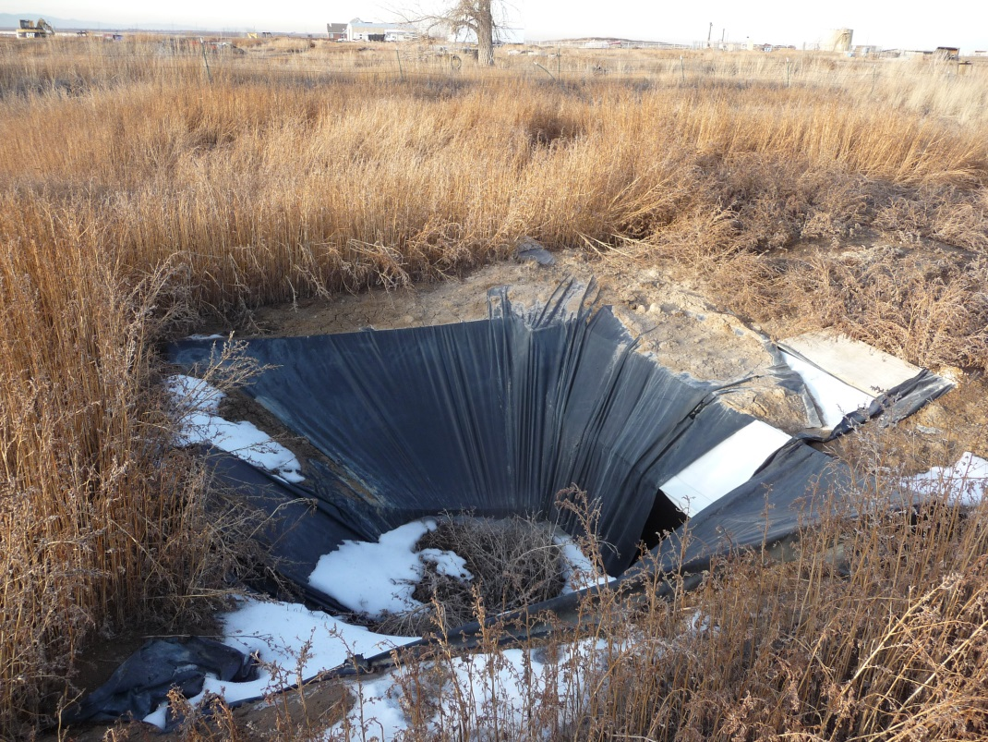
Bean Project, Ft Lupton, CO
Turbine: Endurance S250
Tower: 126’ guyed, tilt, tube
Foundations: 5 unique pads
Materials: $3000 of rebar, concrete, and forming
Labor: 4 people, 6 days
Excavation: 6 mo old, partial cave-ins, no safety taper
Conditions: ice, snow, mud
Solutions: simple shapes, dirt-formed, free-standing?

Slide 7
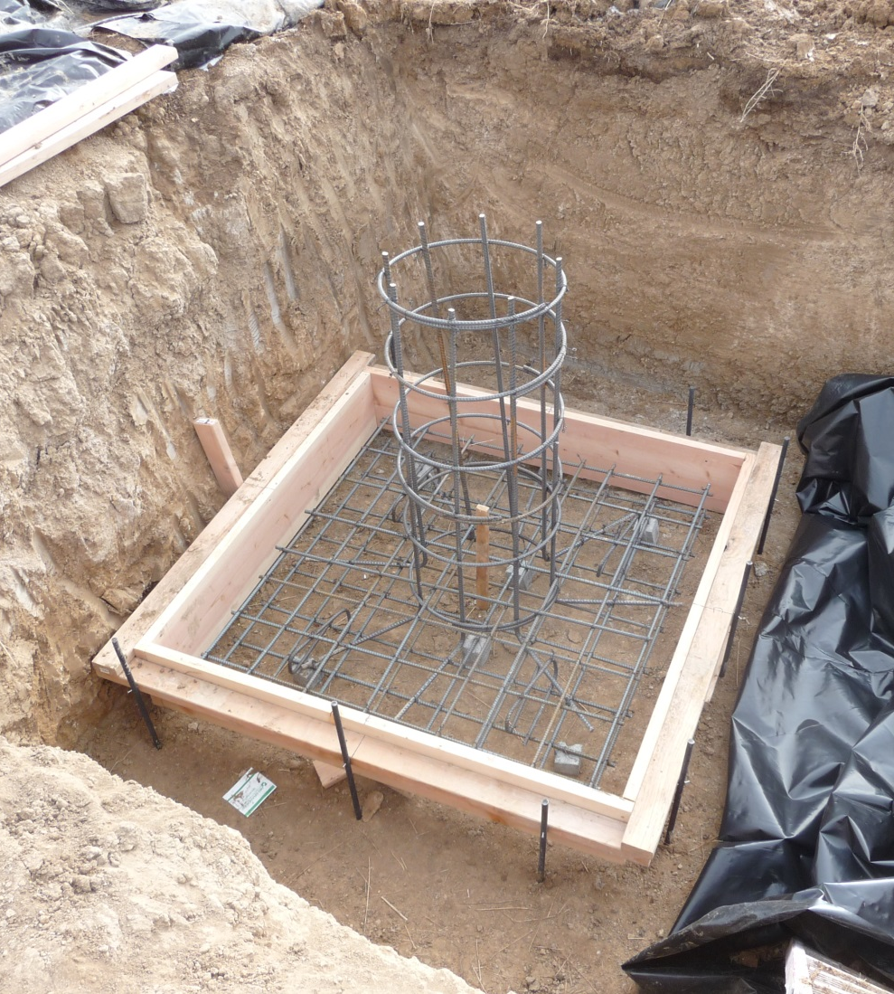
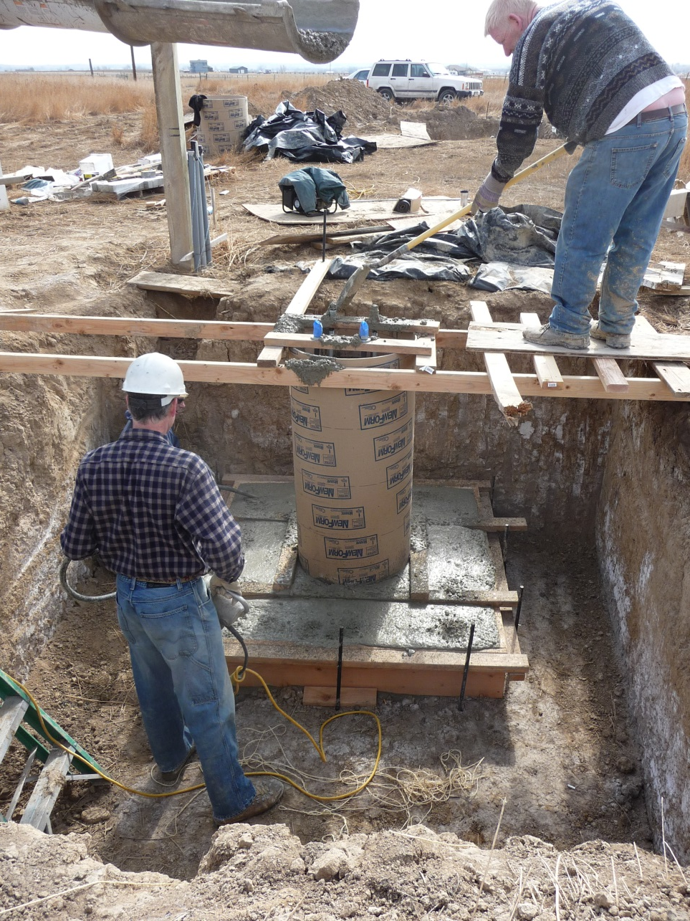
Bean Project, Ft Lupton, CO

Slide 8
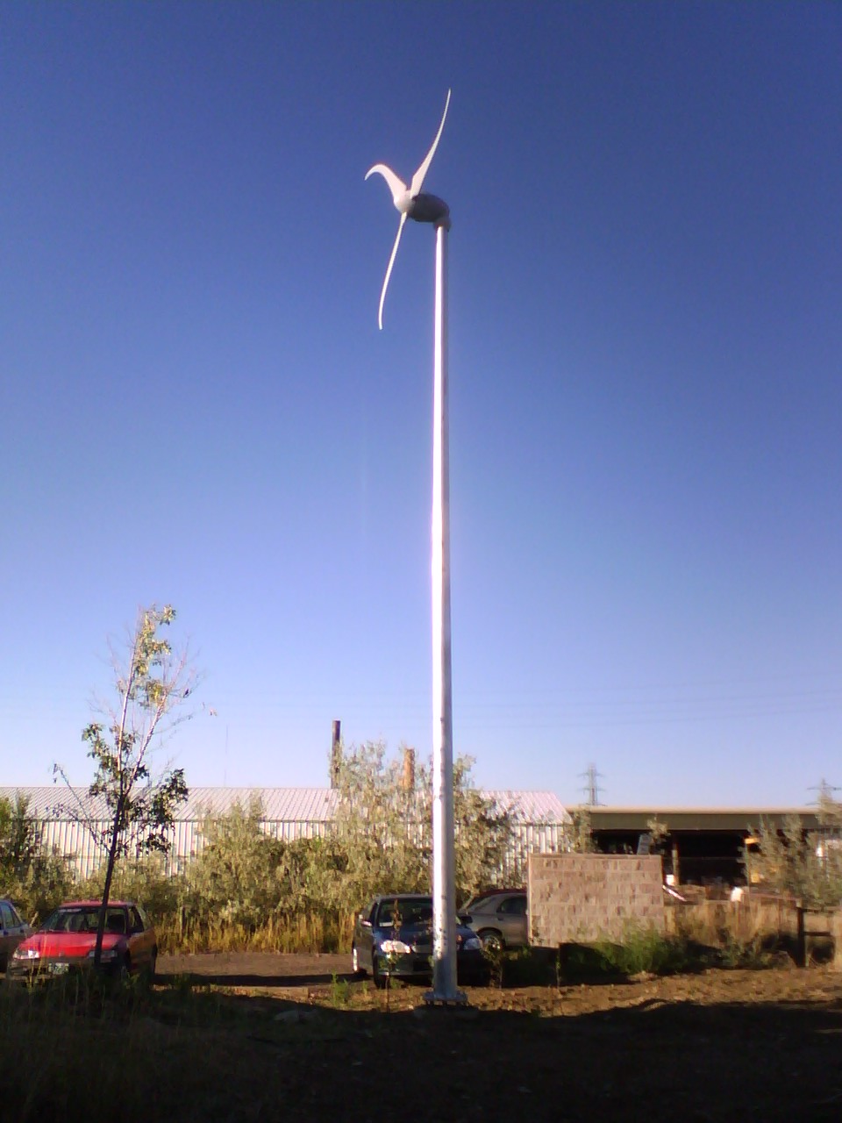
Thorne Project, Boulder, CO
Turbine: Skystream 3.7
Tower: 35’ freestanding monopole
Soils Report: wet mush 50’ away
Foundation: 2’Ø x 26’ pier
Excavation: $3500 to drill and case
Soils Actual: hard, dry Class 4
Materials: $2000 rebar, concrete
Labor: 3 people, 2 days
Issues: OSHA: driller can’t lift rebar
Solutions: cheaper soils testing

Slide 9
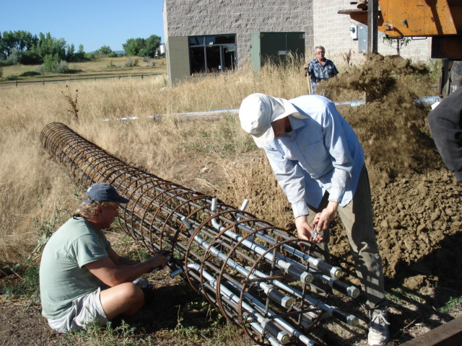
Thorne Project, Boulder, CO

Slide 10
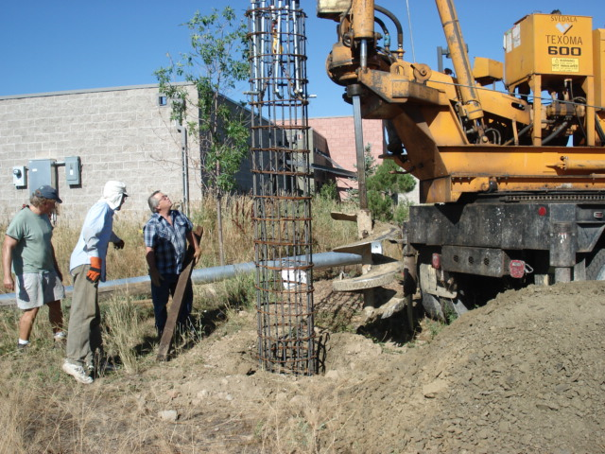
Thorne Project, Boulder, CO

Slide 11
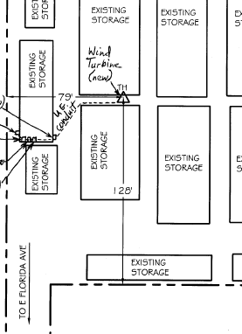
Storage Masters Project, Denver, CO
Turbine: Bergey Excel 10 kW
Tower: 80’ freestanding monopole
Soils Report: wet sand 10’ deep
Foundation 1: pedestal on 15’ square pad
Excavation: undercut buildings; soils engineer says NO
Foundation 2: 6’Ø x 17’ pier
Excavation: drill with polymer fluid to stabilize soil, $10,000
Challenges: continuous cave-in; 10’ alley, drilling-rig access, dirt removal
Solutions: new ARE ballasted steel?

Slide 12
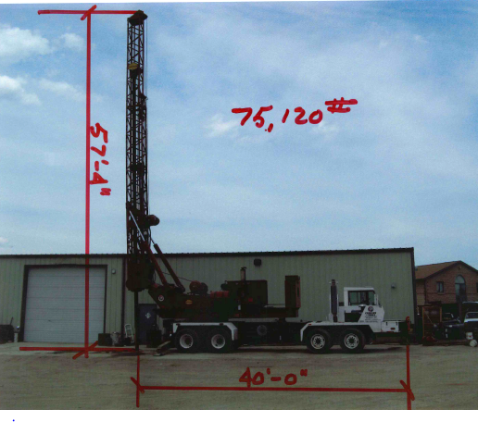
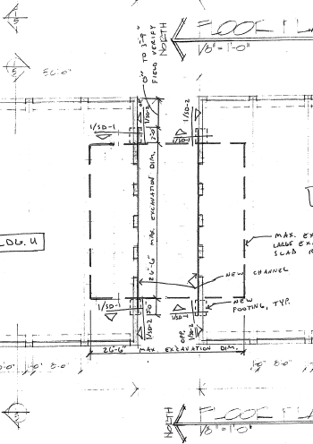
Storage Masters Project, Denver, CO
Coggins and Sons:
Watson 2500 TM with 6’Ø bit

Slide 13
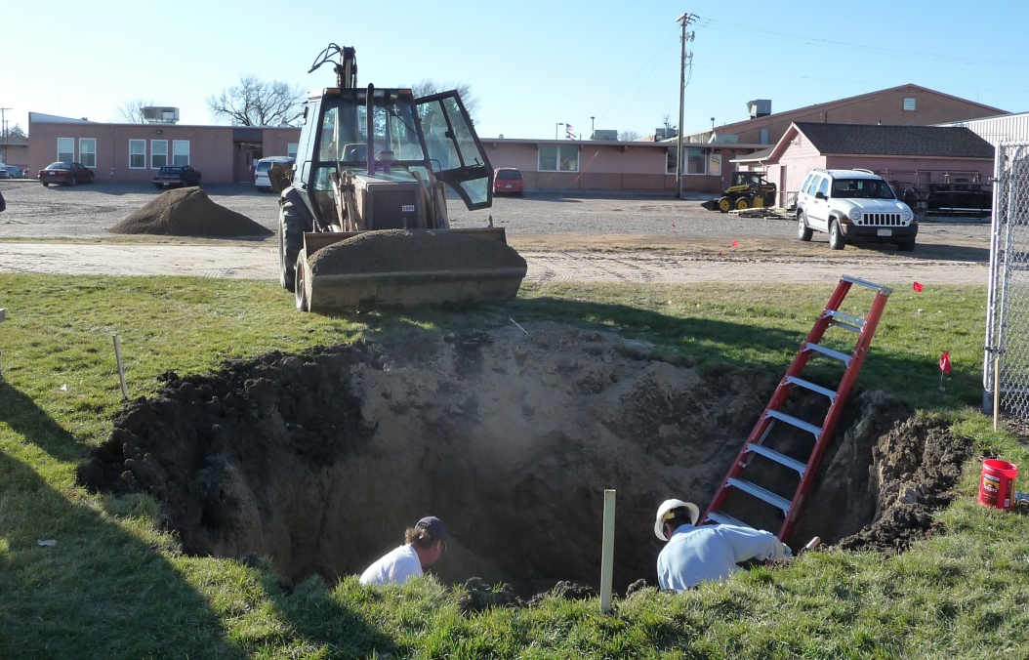
Stratton HS Project, Stratton, CO
Turbine: Skystream 3.7
Tower: 45’ freestanding monopole
AHJ: State of Colorado (school)
Soils Report: bentonite 6’ deep
Excavation: 12’Ø x 7’, OSHA
Foundation: 6’Ø x 4’ SMarT
Form: barrel
Base: structural fill 12’Ø x 3’: CDOT class 5-6, 9” lifts compacted to 98% max dry, moisture 15% +/-2% with testing!
Solutions: deeper concrete, put the civil engineer on the compactor?

Slide 14
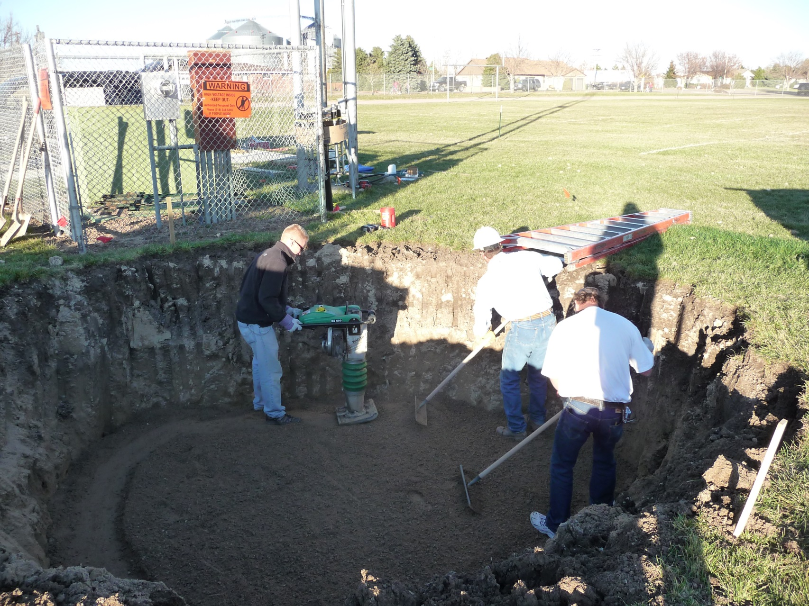
Stratton HS Project, Stratton, CO

Slide 15
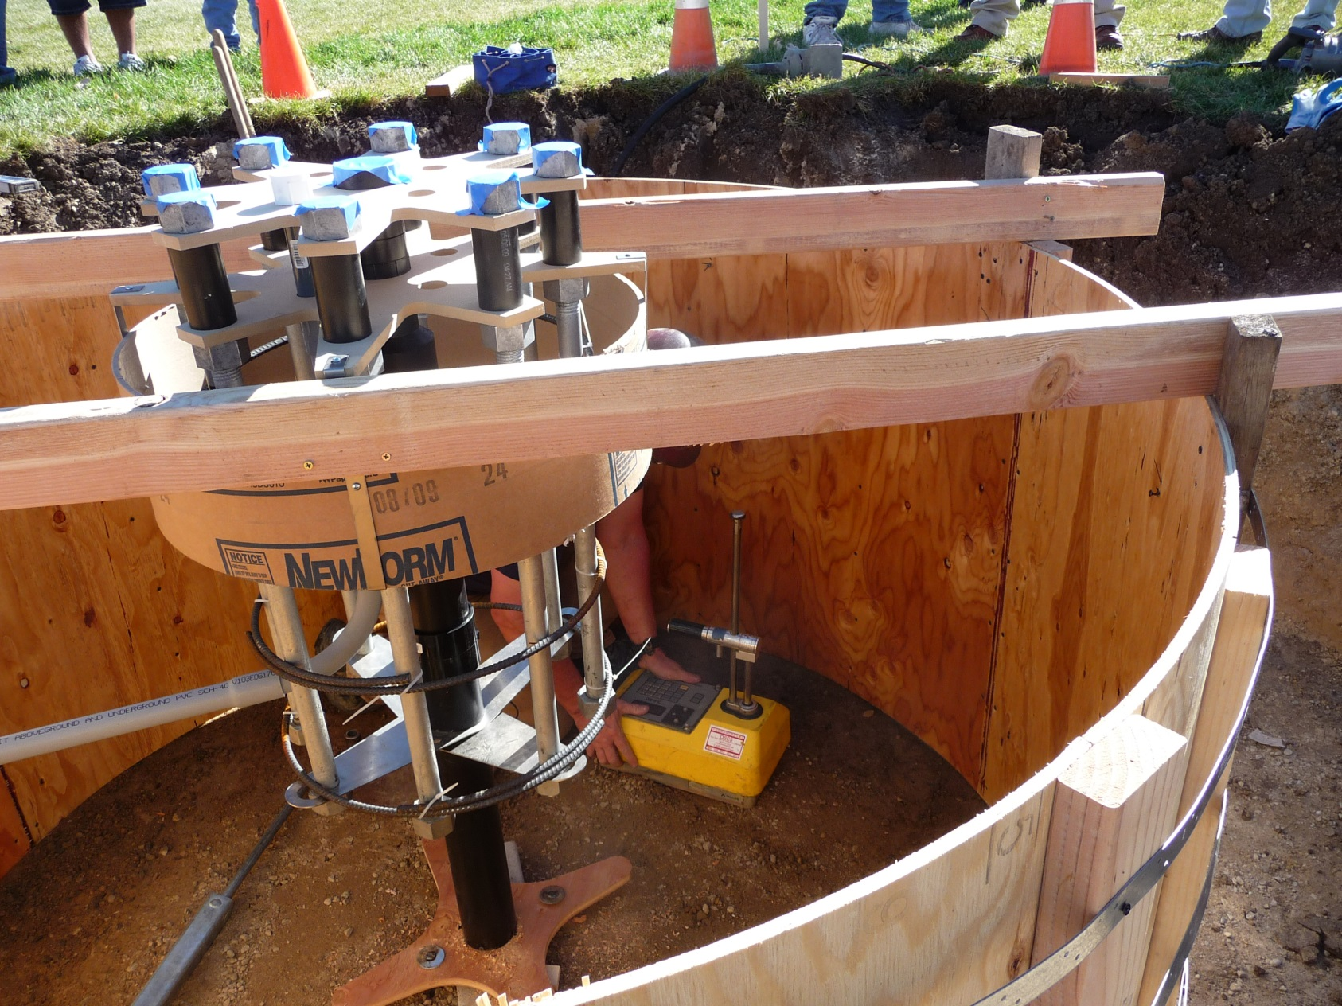
Stratton HS Project, Stratton, CO

Slide 16
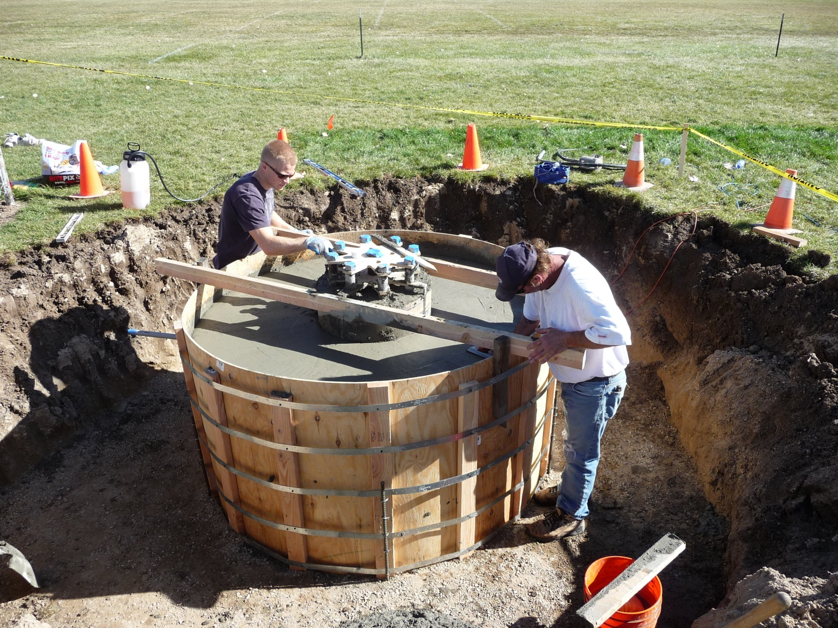
Thank You
Timothy L Olsen
Advanced Energy Systems, LLC
1428 South Humboldt Street
Denver, CO 80210
303-777-3341
www.windtechnology.com

