Slide 1
SMART Wind Support Structures January 14, 2015 David Blittersdorf - CEO

Slide 2
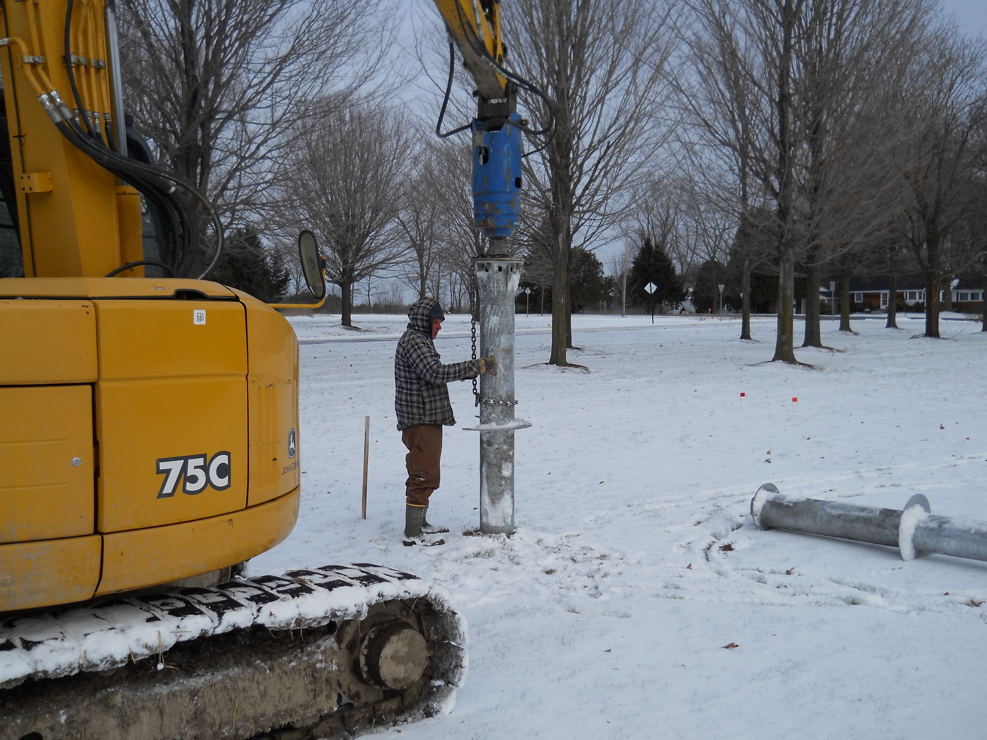
Screw-in Bases
Fast installation – 30 minutes for a 8’ x 10” diameter helical piling
No concrete
Low cost
Critical for one day installation

Slide 3
Helical Piling Installation

