Slide 1

SMART Wind Support Structures Subgroup Meeting
Cost & Material Advances in Tower Design
13-14 January 2015
National Renewable Energy Laboratory
Denver, Colorado
Güneş Demirbaş, P.E.
G-Tower, PLLC
Proprietary and Confidential: The information contained in this document is the sole property of G-Tower, PLLC. Any reproduction in part or as whole without the written permission of G-Tower, PLLC is prohibited.

Slide 2




Houston → Global Oil & Gas Capital
Oil sands / Tar oil
Shale gas
Oil prices
Proprietary and Confidential: The information contained in this document is the sole property of G-Tower, PLLC. Any reproduction in part or as whole without the written permission of G-Tower, PLLC is prohibited.

Slide 3

Offshore Technology Conference → ~108,300 participants in May 2014
Annual Event in Houston, TX
http://2015.otcnet.org/
4-7 May 2015 in Houston, TX
AWEA Wind Power → No more than 20,000 participants in May 2014
Small Wind Conference → ~200 participants in June 2014
Proprietary and Confidential: The information contained in this document is the sole property of G-Tower, PLLC. Any reproduction in part or as whole without the written permission of G-Tower, PLLC is prohibited.

Slide 4
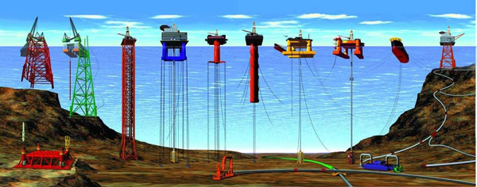
OIL & GAS INDUSTRY ↔ WIND INDUSTRY
Incredible amount of engineering knowledge in the oil & gas industry
(electrical, mechanical, civil, software etc.)
Hydraulic tilt-up oil drilling towers → Hydraulic tilt-up wind towers
Decommissioning of oil or shale gas wells → turning them into green energy
resources. Using them as foundation for wind towers
Offshore structures, oil rigs → offshore wind generation systems
Proprietary and Confidential: The information contained in this document is the sole property of G-Tower, PLLC. Any reproduction in part or as whole without the written permission of G-Tower, PLLC is prohibited.

Slide 5

COLLABORATING with the LEADING INDUSTRIAL COMPANIES
Irrigation equipment manufacturers → Besides irrigation equipment, supplying a small wind turbine and tower to generate sufficient electricity for the irrigation equipment
There are ~80,000 installed
irrigation systems only in Nebraska
Wireless contractors → Installation of
small wind turbines to generate
electricity for the power needs of antenna
towers
Proprietary and Confidential: The information contained in this document is the sole property of G-Tower, PLLC. Any reproduction in part or as whole without the written permission of G-Tower, PLLC is prohibited.

Slide 6
Preparation of tower design specifications
Determination of tower loads
Thrust load: 1.35 safety factor on loads / results of aero-elastic analysis
IEC 61400-2 3.00 safety factor on loads / simplified calculation method
Making decision on adding top deflection limitation criteria or not?
Determination of frequency avoidance bands
Determination of structural design code (ASCE 48-05, ASCE 72, TIA-222-C, etc.)
Tower material specifications (ASTM A572 Grade 65, etc.)
Tower coating specifications (ASTM A123, etc.)
Tower climbing specifications
OSHA Safety requirements
Operation and maintenance requirements
Transportation and storage requirements
Preparation of foundation design family for various soil conditions
Proprietary and Confidential: The information contained in this document is the sole property of G-Tower, PLLC. Any reproduction in part or as whole without the written permission of G-Tower, PLLC is prohibited.

Slide 7
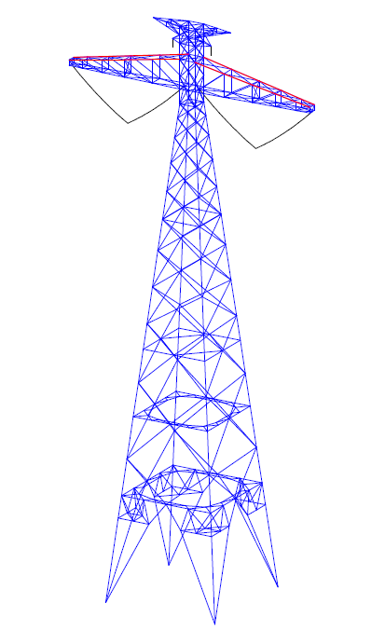
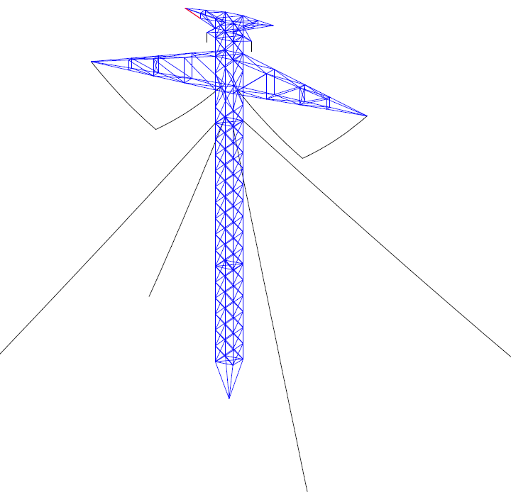
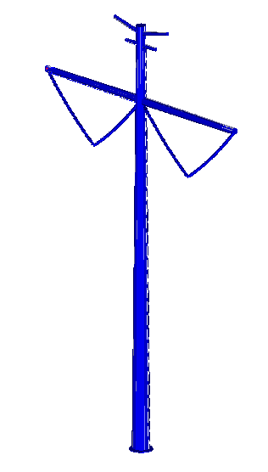
Potential structure options are analyzed by preliminary engineering in order to
determine the most cost effective structure in electric transmission line projects.
In-place cost comparison = tower + installation + foundation + O&M
Lattice tower or tubular pole?
Self-supporting or guyed?
Proprietary and Confidential: The information contained in this document is the sole property of G-Tower, PLLC. Any reproduction in part or as whole without the written permission of G-Tower, PLLC is prohibited.

Slide 8
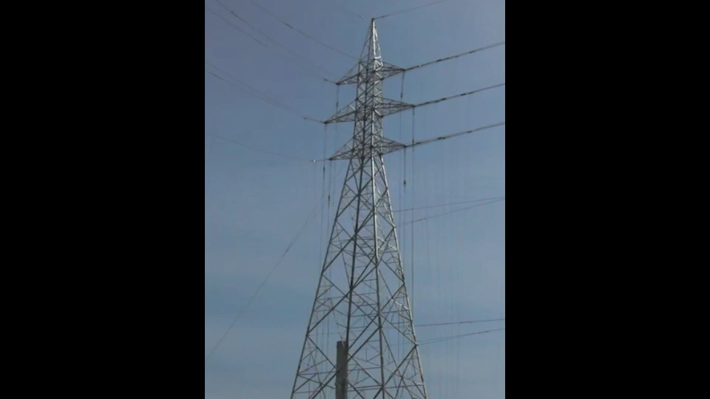
Proprietary and Confidential: The information contained in this document is the sole property of G-Tower, PLLC. Any reproduction in part or as whole without the written permission of G-Tower, PLLC is prohibited.

Slide 9
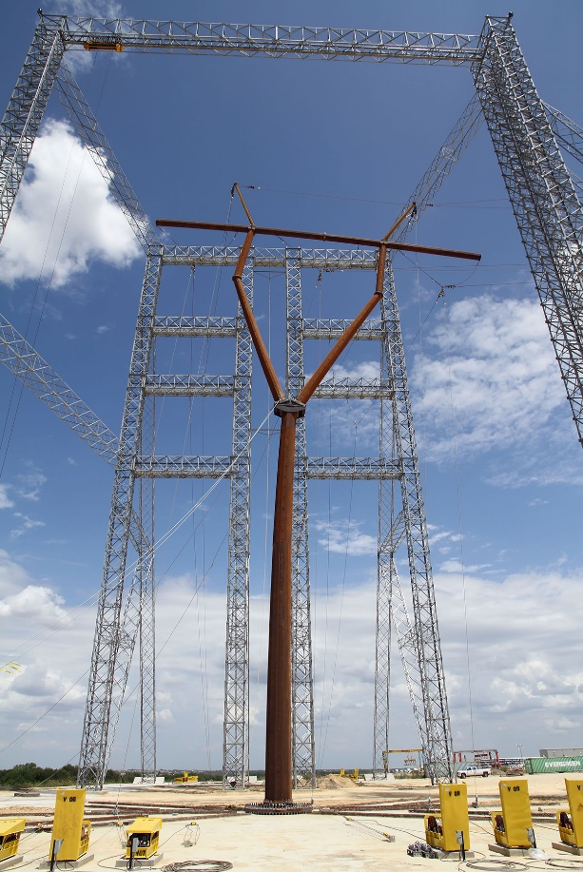
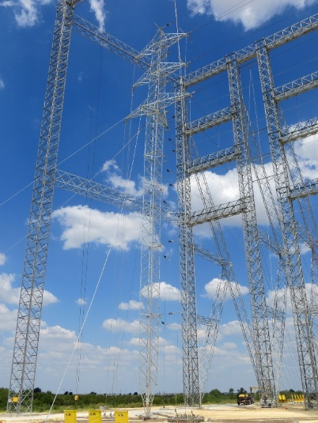
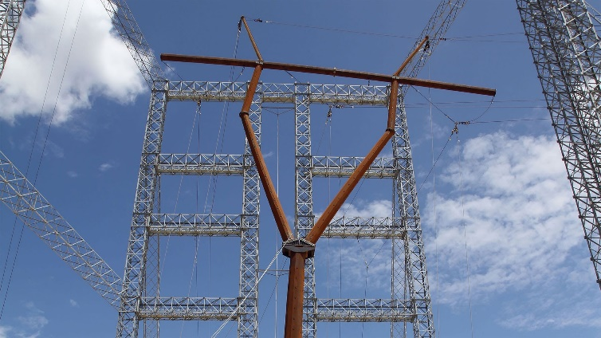
Testing Facility in Alvarado, TX (50-50 JV between Sabre & Brametal)
Proprietary and Confidential: The information contained in this document is the sole property of G-Tower, PLLC. Any reproduction in part or as whole without the written permission of G-Tower, PLLC is prohibited.

Slide 10
Tilting with an actuator (Tilting Monopoles)
Tilting with a winch (Towers with Gin Poles)
Climbable guyed (Guyed Lattice)
Climbable free standing (Monopoles and Free standing Lattice)
Pole budgetary pricing (High Volume, Qty > 10) : $1.3 - $1.5 / Ibs
Pole budgetary pricing (Low volume, Qty < 10) : $1.5 - $1.7 / Ibs
Hydraulic tilt pole budgetary pricing: $2.0 - $2.5 / Ibs
Plus hydraulic cylinder and power pack cost ($10K to $25K)
Welded gussets, flange flatness, and tight tolerances of tilt up functions significantly increase the labor cost of poles and support structures.
3-Leg pipe lattice budgetary pricing: $1.2 - $1.4 / Ibs
4-Leg angle lattice budgetary pricing: $0.9 - $1.1 / Ibs
Above prices include galvanize, made in the U.S, Ex-works
Overseas supply has potential to reduce price 10% including freight
Proprietary and Confidential: The information contained in this document is the sole property of G-Tower, PLLC. Any reproduction in part or as whole without the written permission of G-Tower, PLLC is prohibited.

Slide 11
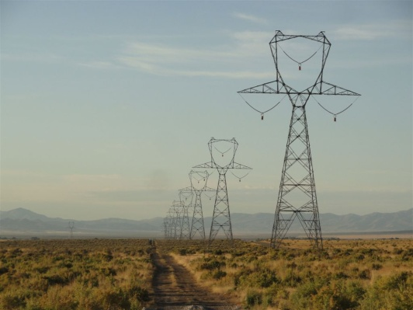
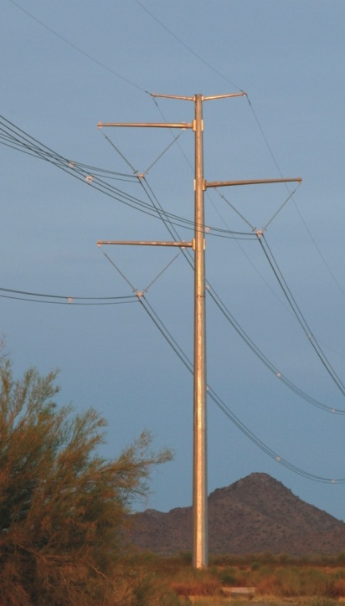
Why not manufacturing
small wind towers in the U.S?
$2 Billion Market in the U.S & Canada
Transmission & Distribution & Substation
Structures (lattice & pole)
Major Pole Manufacturers in the U.S:
Valmont Industries
Thomas & Betts (Meyer or Trinity)
Sabre Industries
Fort Worth Towers
Rohn
Pelco
Dis-Tran
Summit Utility Structures
Falcon Steel
Maico Industries
TAPP (Mexican)
Chinese & Indian Poles
Proprietary and Confidential: The information contained in this document is the sole property of G-Tower, PLLC. Any reproduction in part or as whole without the written permission of G-Tower, PLLC is prohibited.

Slide 12
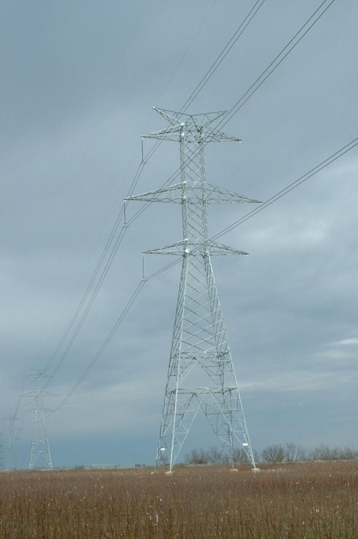
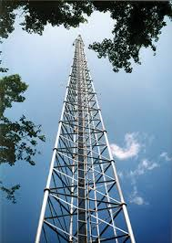
Major 3-Leg Pipe Lattice Manufacturers in the U.S:
Pirod (Valmont Industries)
Microflect (Valmont Industries)
Sabre Industries
Fort Worth Towers
Rohn
Nello
Major Angle Lattice Manufacturers in the US:
Falcon Steel
Jyoti Americas
Global Angle Lattice Manufacturers:
SAE Towers (KEC, Mexico)
Comemsa (Mexico)
Formet (Trinity, Mexico)
Mitas Energy (Turkey)
Brametal (Brazil)
Kalpataru (Indian)
Lockweld (Canadian)
Fabrimet (Canadian)
Proprietary and Confidential: The information contained in this document is the sole property of G-Tower, PLLC. Any reproduction in part or as whole without the written permission of G-Tower, PLLC is prohibited.

Slide 13
Potential Monopole Cost Improvement in the U.S:
Pole Manufacturer Brake formed, longitudinally seam welded pole section, base plate welded
General Steel Shop
Welding top flange, man & hand hole, platform, climbing, all accessories, etc.
Coating Facility
Galvanizing and/or painting
CUSTOMER DELIVERY
Manufacturing Inspection
Pre-shipment Inspection
Proprietary and Confidential: The information contained in this document is the sole property of G-Tower, PLLC. Any reproduction in part or as whole without the written permission of G-Tower, PLLC is prohibited.

Slide 14
60 Degree Angle - Hot Rolled
Reducing tower weight 10% - 15%
Reducing ground area usage
No welding
Reducing tower cost 12% - 20%
Proprietary and Confidential: The information contained in this document is the sole property of G-Tower, PLLC. Any reproduction in part or as whole without the written permission of G-Tower, PLLC is prohibited.

Slide 15
Hydraulic Tilt Towers Project Management Process
Wind Turbine Manufacturer
Tower Design Firm
Hydraulic Design & Supply Firm
Tower Manufacturer
Foundation Design Firm
Wind Turbine Dealer
Contractor
Project Completion
Proprietary and Confidential: The information contained in this document is the sole property of G-Tower, PLLC. Any reproduction in part or as whole without the written permission of G-Tower, PLLC is prohibited.

Slide 16
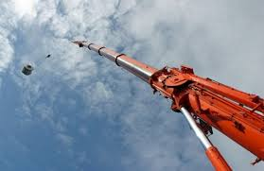
Tight tolerances in hydraulic towers
Tower manufacturer ↔ machinery shop ↔ crane manufacturer’s input
It is more than standard pole manufacturing
Proprietary and Confidential: The information contained in this document is the sole property of G-Tower, PLLC. Any reproduction in part or as whole without the written permission of G-Tower, PLLC is prohibited.

Slide 17
QUESTION?
We do have certification process for small wind turbines.
Tower & foundation systems are part of small wind turbines.
Do we check tower & foundation designs as part of the certification process?
If not, why do not we check tower & foundation designs as part of the certification process?
Or
Why do not we certify tower & foundation systems?
Proprietary and Confidential: The information contained in this document is the sole property of G-Tower, PLLC. Any reproduction in part or as whole without the written permission of G-Tower, PLLC is prohibited.

Slide 18
CERTIFICATION of TOWER & FOUNDATION SYSTEMS
Review of tower load calculations
Review of tower specifications
Review of structural analysis
If any, review of tower tilt-up function
Providing feedback on tower design
Review of foundation loads
Review of foundation analysis
Providing feedback on foundation design
Review of tower & foundation installation manual
Review of tower operation & maintenance manual
Prototype
Certifying certain tower types & heights for certain foundations for certain soil classifications
Success of each tower & foundation system means success of turbine manufacturer which means success of the Small Wind Industry!
Proprietary and Confidential: The information contained in this document is the sole property of G-Tower, PLLC. Any reproduction in part or as whole without the written permission of G-Tower, PLLC is prohibited.

Slide 19
THANK YOU!
G-Tower, PLLC
www.g-tower.com
gdemirbas@g-tower.com
(205) 616 4905
Houston, TX
Proprietary and Confidential: The information contained in this document is the sole property of G-Tower, PLLC. Any reproduction in part or as whole without the written permission of G-Tower, PLLC is prohibited.

