Slide 1
Protective Coatings for Wind Energy
DWEA SMART Wind Support Structure Subgroup
NREL
Golden, CO

Slide 2
Krent Aberle The Sherwin-Williams Company
24 years with Sherwin-Williams
NACE 3 Certified Inspector
Expert in Corrosion Protection of Assets

Slide 8
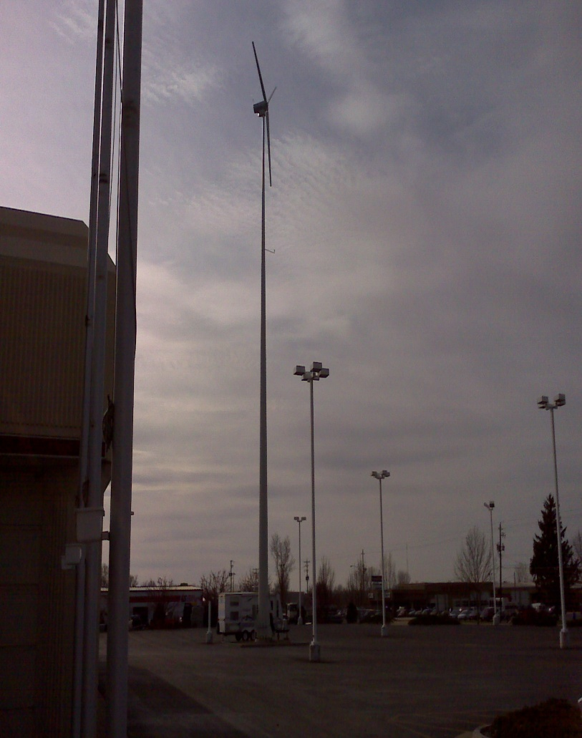
Galvanizing vs. Zinc Rich
Surface Preparation
Transportation cost
Cathodic protection
Life expectancy
Zinc Rich- Inorganic vs Organic
JPCL cost/performance analysis

Slide 9
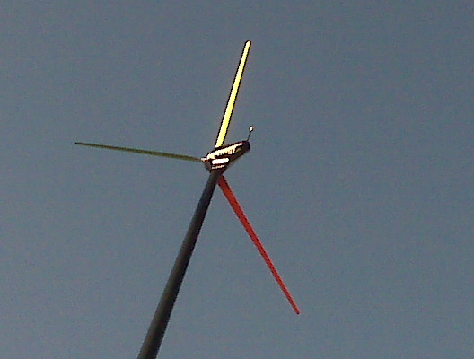
Coatings
Substrates- Steel, Composites, Concrete
Surface Preparation
Barrier Protection
Life expectancy

Slide 10
Next Generation Coatings
Impact Resistant- hail, grit, transport
Ice shedding, self cleaning
Additives- MIO, Glass, Nano
Polyurea
Life expectancy

