Slide 1
SMART Wind Consortium
Support Structures
Gaps & Opportunities Discussion
Trudy Forsyth
January 13, 2014
NREL/RSF
Notes:
JJ: How we named the project. SMART Wind concept from Jan 2013 DWEA Board retreat. Roadmap will be consensus based.

Slide 2
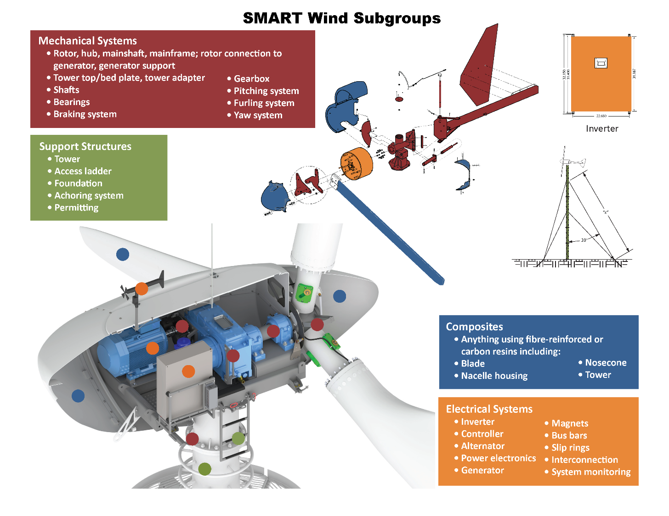

Slide 3
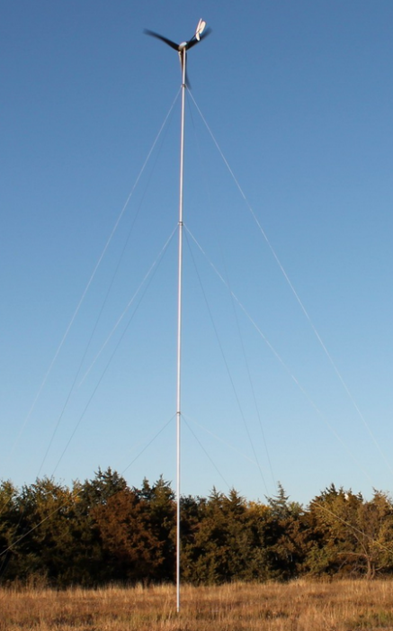
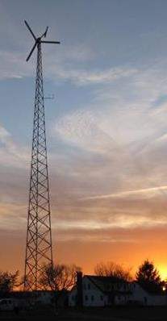
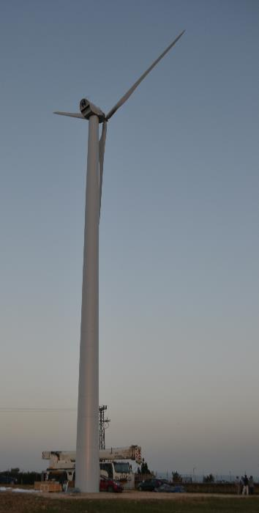
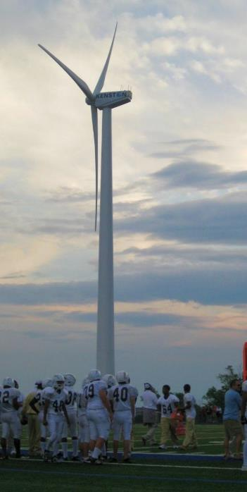
Reminder: Although we are trying to focus on issues through subgroups,
this is a complete wind turbine SYSTEM

Slide 4
Focus on opportunities and gaps that enable:
Turbines to be more cost competitive
Turbines to be more productive
Installation costs go down with safe installations

Slide 5
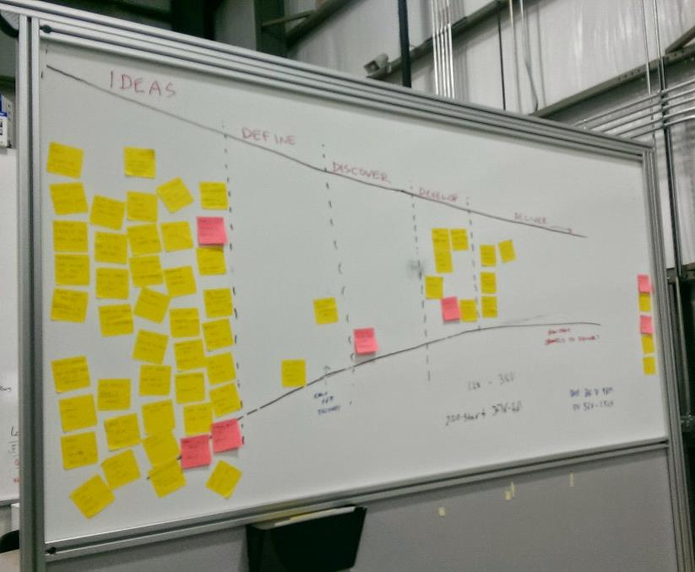
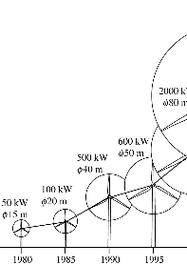
Another reminder:
Use your notecards
Roadmap

Slide 6
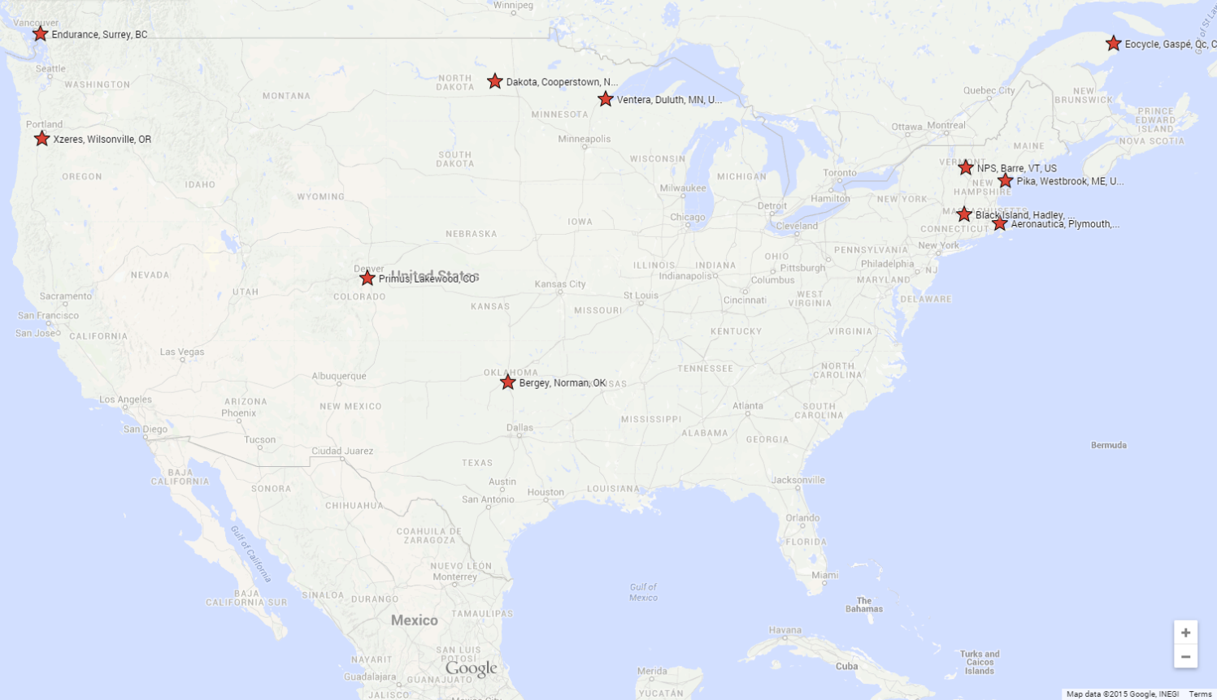
OEM Steering Group Member Locations

Slide 7
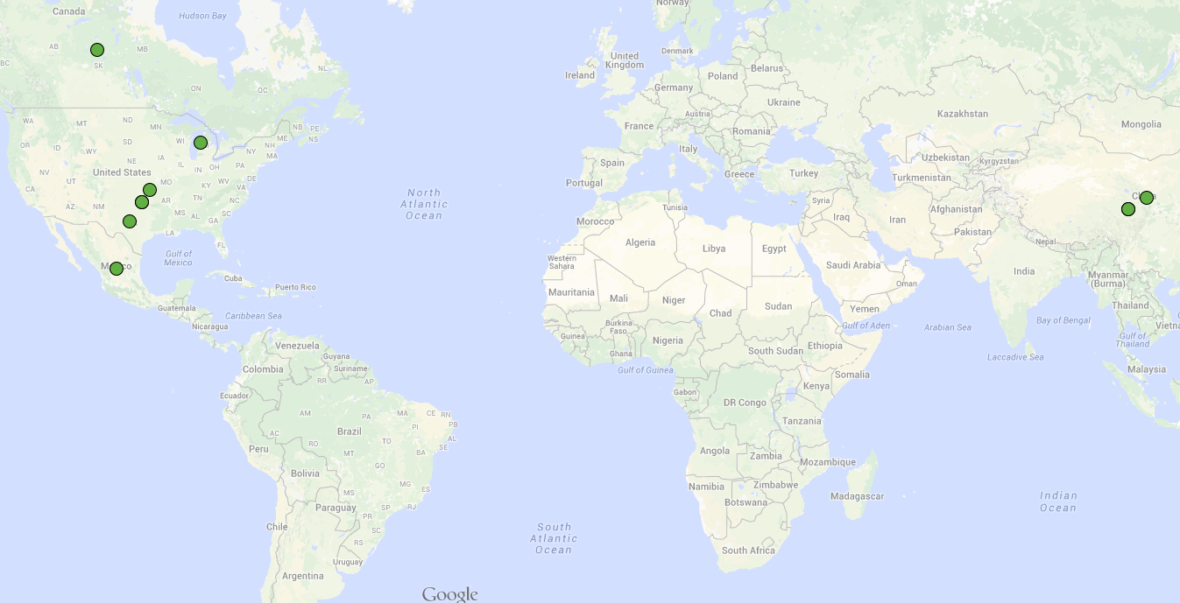
Support Structure supply chain
Part | Sourced | Manufactured
Tower | Norman, OK, USA | Norman, OK, USA
Tower | Asia | Asia
Tower | USA | USA
Tower | USA | China
Tower | USA | Mexico
Towers | Texas, US | Texas, US
Towers | Michigan, US | Michigan, US
Towers | Norman, OK | Norman, OK
Turbine base | Canada | Canada
Turbine base | Asia | Asia

Slide 8
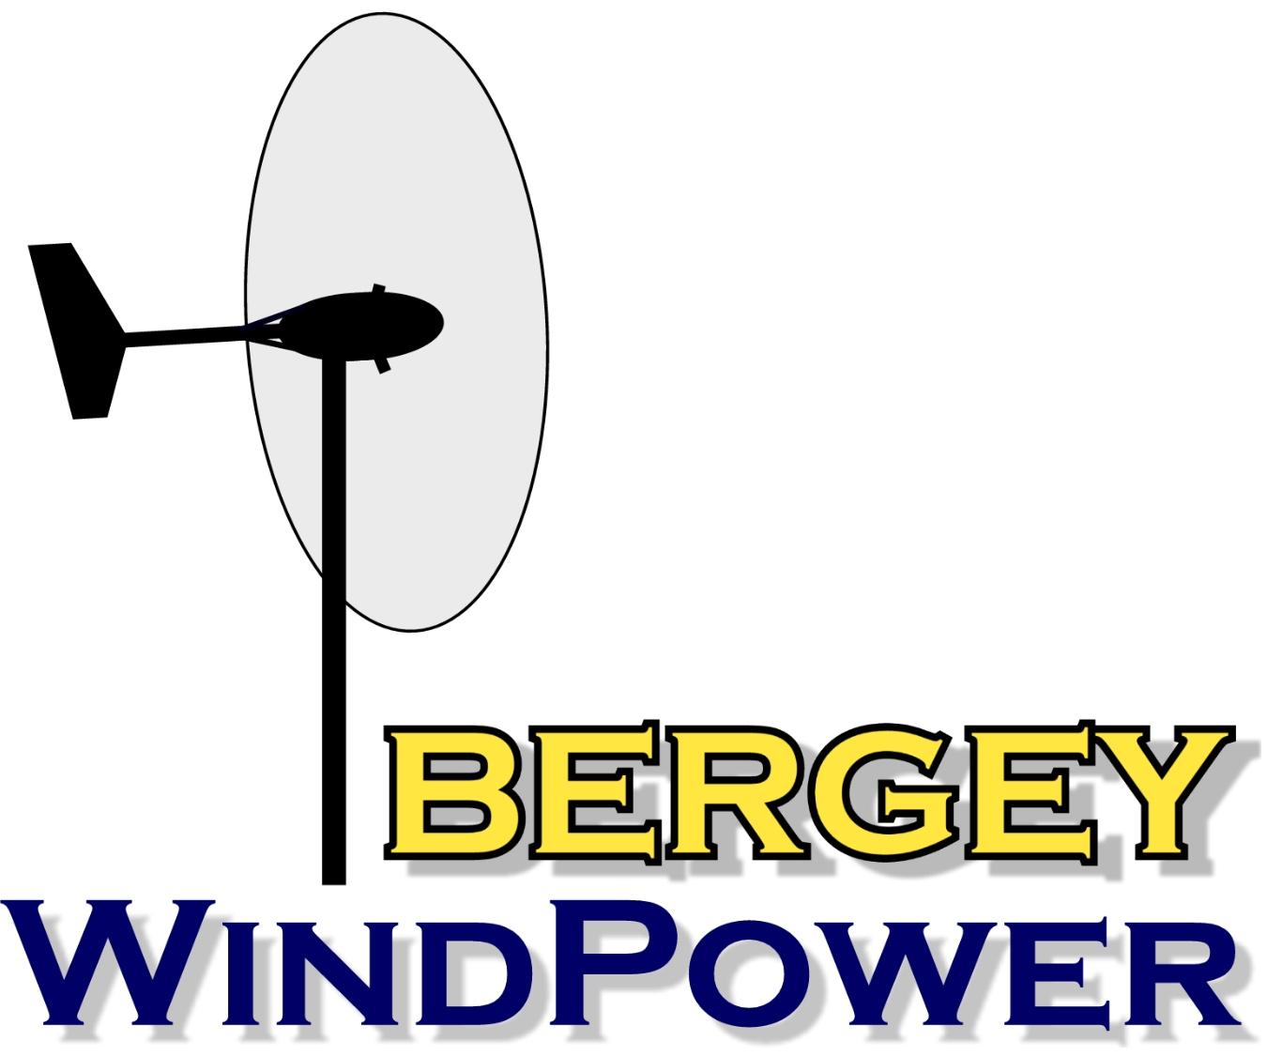
Burgundy text for OEMs indicating interest in Support Structure
Aeronautica Windpower
Bergey Windpower
Black Island Wind Turbines
Dakota Turbines
Endurance Wind Power
Eocycle Technologies
Northern Power Systems
Pika Energy
Primus Windpower
Ventera Wind
Xzeres Wind

Slide 9
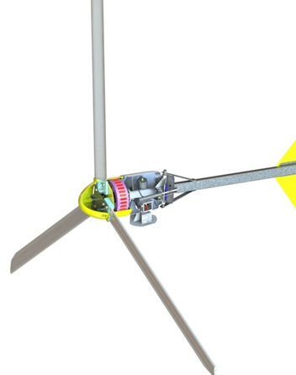
Bergey Windpower Company Contact: Mike Bergey
Summary
Turbines: Excel 10 & 6, both AWEA certified by SWCC
In business 37 yrs, first turbine in 1980
Opportunities in blade material advances, process improvements, automation
Manufactured in Norman, OK
Interested in bringing some components currently produced by vendors in-house
Subgroups: Mechanical, Electrical, Composites, Support Structures
www.bergey.com

Slide 10
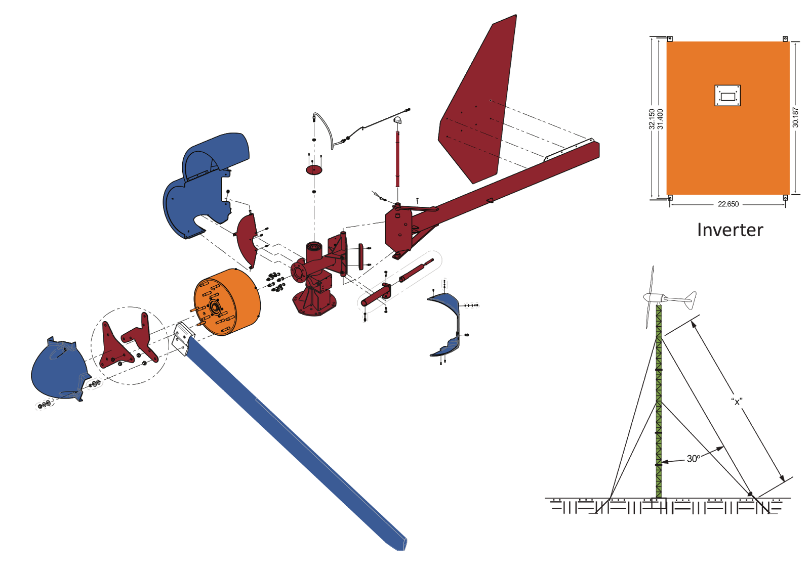
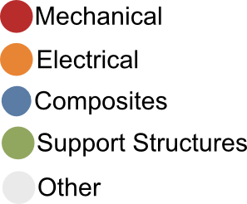
Bergey Excel 10 exploded view

Slide 11
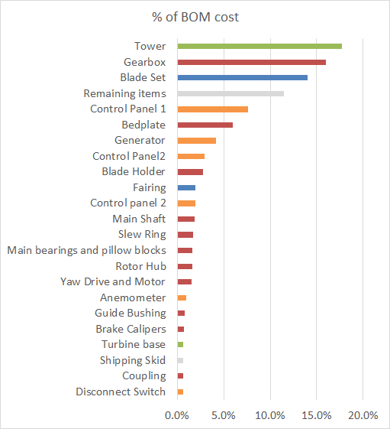
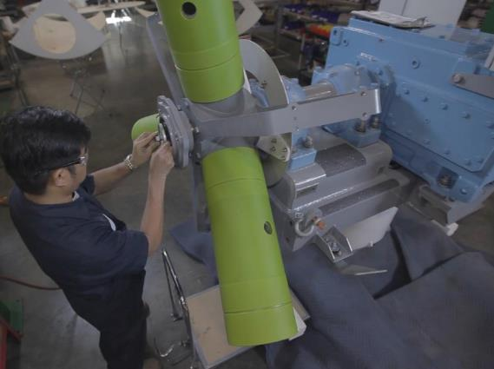
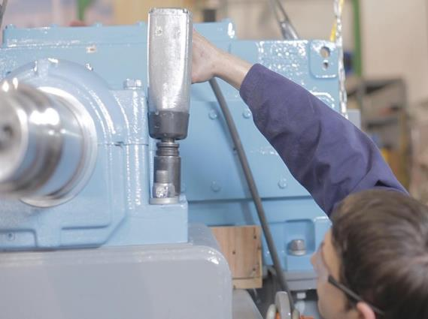
Endurance E3120

Slide 12
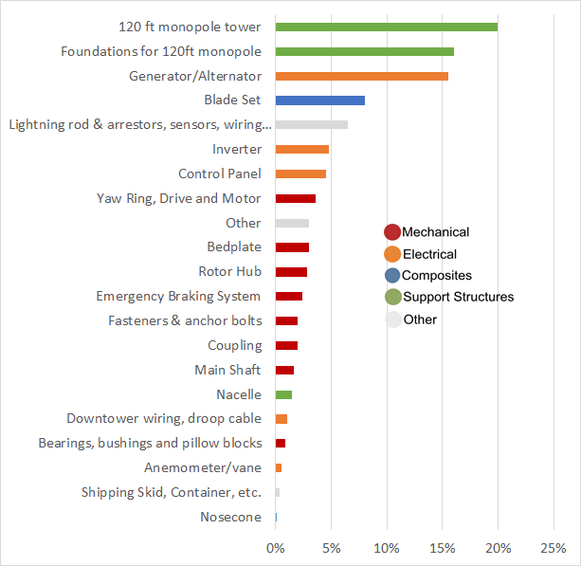
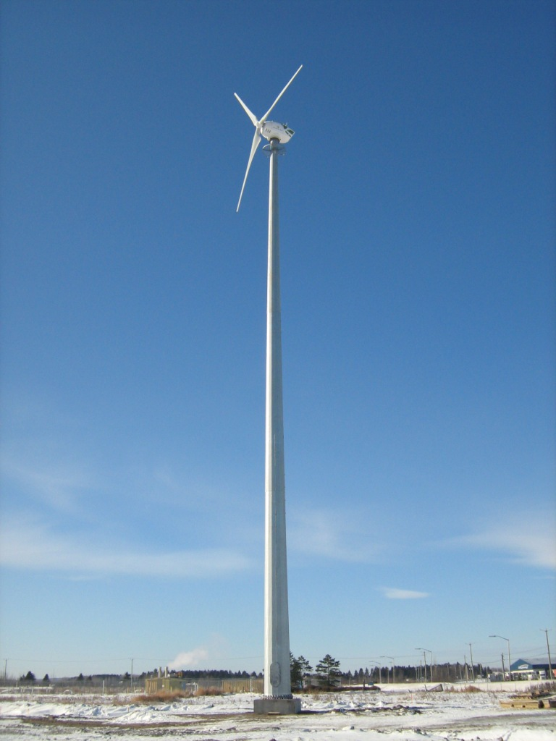
Eocycle 25 Top Level BOM

Slide 13
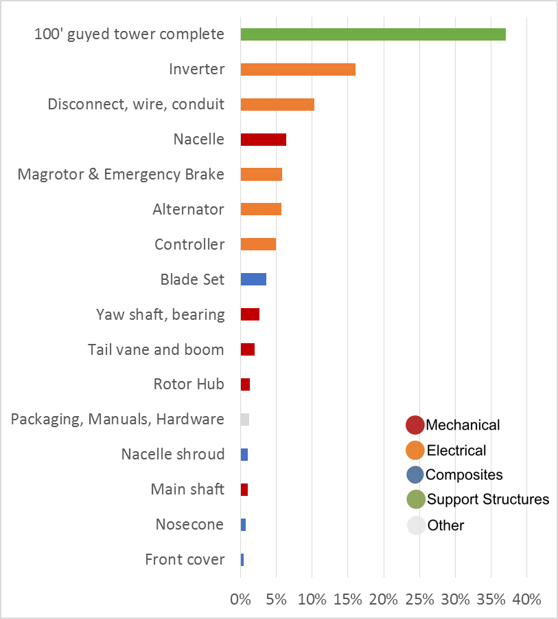
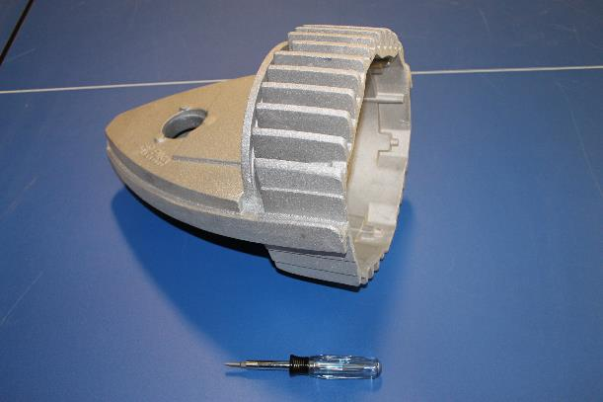
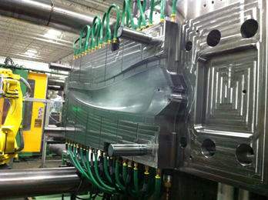
Pika T701 BOM

Slide 14
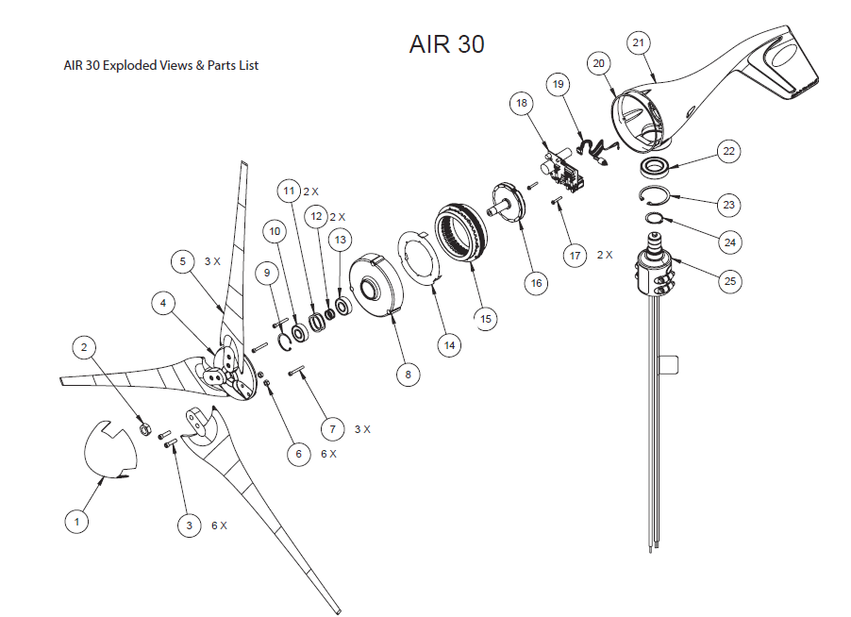
Interested in monopole towers that can incorporate solar panels
www.primuswindpower.com

Slide 15
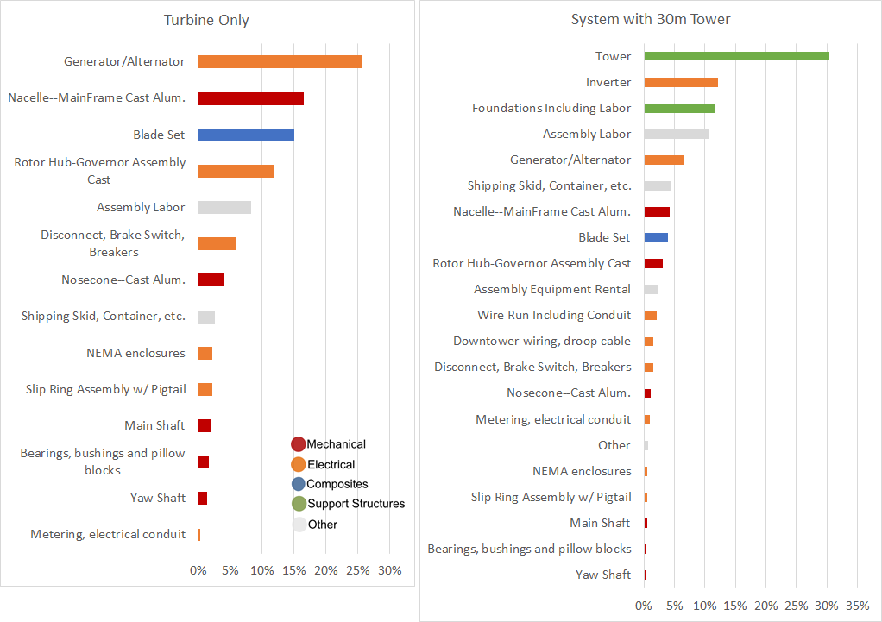
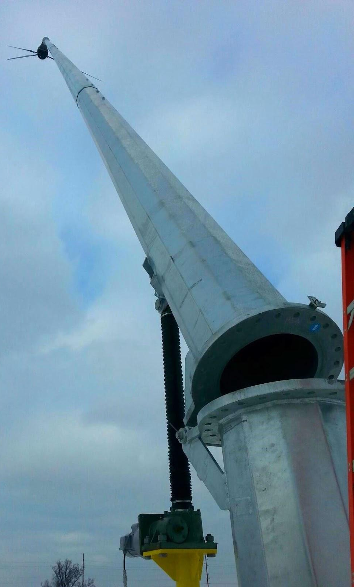
Ventera Wind VT10

Slide 16
Other opportunities/ideas
Identify regional manufacturer expertise (steel forging, electrical components, casted items, etc) and encourage entry/ conduct meetings with such suppliers to enter wind turbine sector
Specialized and cost effective manufacturing of stators, rotors, windings and housing for the alternator / generator
Thermoplastic, injection molded composite blades (http://www.osti.gov/scitech/biblio/921599)
Absence of dynamic aspects of design and loads analysis
Speak directly with the machining companies that manufacture product
Alternator design and manufacturing methods for cost reduction and reliability improvement is critical
Power electronics manufacturing for small production runs at reasonable cost

Slide 17
Barriers/Opportunities
How to lower costs?
If making towers, how to lower fixturing costs? (most source towers)
How to create foundations that are manufactured solutions and less time consuming?
Is there a possibility of using AL tower given the problem of buckling?
Are there advantages for welded on-site towers?
Is there a way to reduce the flanges from tower since they are expensive to make?
Should the industry consider slip-fit, nested towers? Is anyone manufacturing these for 50m and less? Is 50m the max Endurance tower height?
What is the latest in coating towers for galvanic protection?
Is there a better dynamic simulation capability for monopole towers?

Slide 18
SMART Wind Support Structure info from OEM Steering Group
SSL | Self supporting lattice
GL | Guyed lattice
SSM | Self supporting monopole
GMP | Guyed monopole
TMP | Tilting monopole
GTU | Guyed tilt up

Slide 19
OEM | Bergey Windpower | Endurance Windpower | Eocycle Technologies | Pika Energy | Primus Windpower | Ventera Wind | Xzeres Wind
Website | bergey.com | endurancewindpower.com | eocycle.com | www.pika-energy.com | www.primuswindpower.com | www.venterawind.com | www.xzeres.com
Turbines (Tower Top Weight) | Excel 6 (800 lb), Excel 10 (1,200 lb) | E3120 (8,900 lb), E4660 (14,300 lb) | Eocycle 25 (4,960 lb) | T701 (93 lb) | Air series (13 lb) | VT10 (580 lb) | 442SR (2,300 lb), Skystream (170 lb)
Year in business | 37 | 7 | 13 | 4 | 2 | 3 | 5
Year 1st turbine | 1980 | 2009 | 2010 | 2013 | 1995 | 2007 | 2010
Top Towers | 120' SSL | 24 m SSM | 60-120' SSM | 60-100' GTU (Bergey) | Customer supplied | 70-90' TMP | 442SR: 60' TMP
 | 100' SSL | 36 m SSM | 60-120' GMP | 42-63' GTU kits | 27-45' GTU kit |  | 80-120' SSM
 | 140' GL | Legacy SSL | 60-120' GTU | Fiberglass SSM | Monopole TBD |  | 80-140' SSL
 | 80' SSL | 42 m SSM (Nova Scotia) |  | SSM |  |  | SS: 45-60' SSM
 | 100' GL | 30 m SSM |  | Retrofit existing tower |  |  | 45' TMP
Top Foundations | SSL: spread, anchor to rock, pier/pad | pier/pad | pier/pad |  |  | pier/pad | pier/pad
 | GL: guy anchors, base pad |  | limited precast |  |  | pad | pier
 |  |  |  |  |  |  | SMarT (SS)
Misc |  |  | Arctic option | Very interested in finding US manufacturer |  |  | Very interested in finding US manufacturer
SMART Wind Support Structure info from OEM Steering group

Slide 20
Research
Absence of dynamic aspects of design and loads analysis, particularly for monopole towers
Co-design a foundation that can be produced with cheap steele and used by multiple OEMs
Foundation are cross-OEM, near-term solutions to lower cost.
Manufacturing
Manufactured solutions for foundations, save site logistics cost and complexity
Find small batch/tailored galvanizing partner
Alternatives to expensive Navy spec organic zinc paint?
Find out about robotic welding
How to get high quality, repeatable tower welds?
Need fixturing?
How to bring tower manufacturing back to US? 65% discount in China – seems very unlikely
Explore slip-fit, tapered compared to mechanically coupled towers
General OEM interest in monopole towers but no solid US supply?
OEMs merge to develop monopole tower supply?

Slide 21
Other U.S. Tower Manufacturers
Rohn Products – Jeff Ahrends 309-453-1701
Swager Telecommunications – Tim Swager 260-495-2515
Ventower – Scott Viciana 757-477-8103
National Poles – John Van Haren 734-461-2848
Nello Corporation – no response
Trinity Structural Towers – no response
Sabre Industries – no response
Valmont/China became ARE – Called US rep no response

