Slide 1

Wind Diesel and Islanded-Grids
Thursday April 16, 2015
Moderated by Greg Price
Speakers:
Stephanie Nowers
Ian Baring-Gould
Trevor Atkinson

Slide 2
Stephanie Nowers
Facilitator
Island Grid Resource Center
Anchorage, Alaska

Slide 3
Islanded Grid Resource Center
Alaska Update:
April 16, 2015
Notes:
Introduction and review of what’s to come

Slide 4
What is the IGRC:
Educational networking group for those working on islands and islanded grids
Started in 2014
Participants
  Alaska, Maine, New Hampshire, Massachusetts, Rhode Island, Hawaii, US Virgin Islands, Guam, Commonwealth of Northern Marianas, American Samoa
Funded through 3-year grant from US. Department of Energy’s WindExchange program

Slide 5
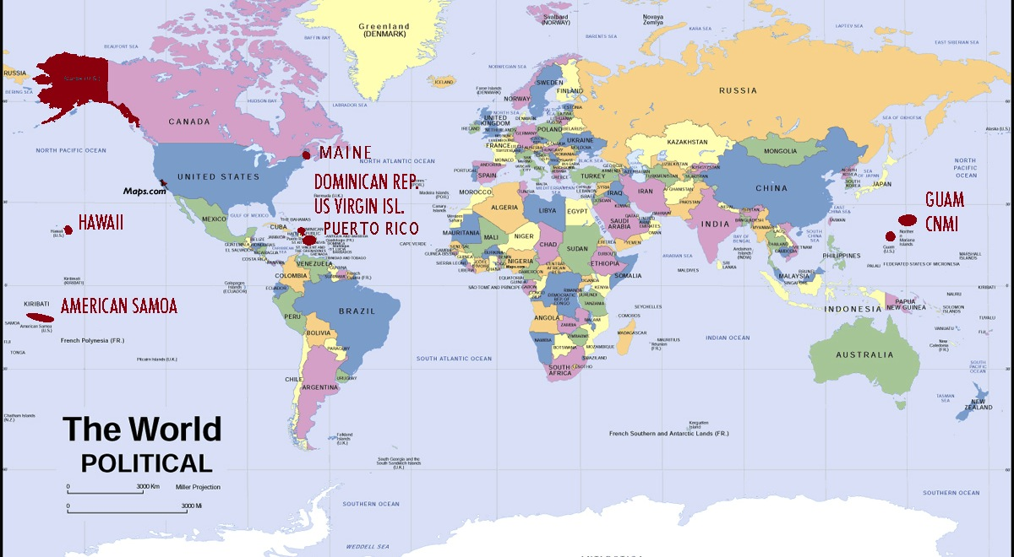
Geography
10 time zones • Range of climates

Slide 6
Participants
Research institutions
Government and tribal organizations
Universities
Trade Groups like Distributed Wind Energy Association
Supply chain - wind turbine manufacturers, consultants, control system experts

Slide 7


Renewable Energy Alaska Project (REAP) is:
Since 2004, Alaska’s first education and advocacy group for renewable energy and energy efficiency.
Coalition of small and large electric utilities and utility interests, environmental groups, consumer groups, businesses, Alaska Native organizations and energy agencies with the goal of “increasing the production of renewable energy in Alaska and the use energy efficiency.”
Notes:
Two main organizers – REAP and Island Institute

Slide 8
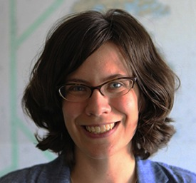
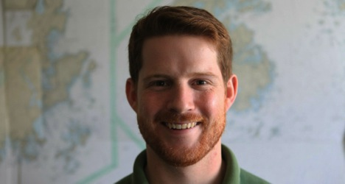
Island Institute
Founded over 30 years ago
Over 40 staff and 10 Fellows
Successful history of building stakeholder networks
Works on all aspects of island life
Created the New England Island Energy Network

Slide 9
Focus
Wind-diesel hybrid systems
Integration of large wind on islanded grids
Impacts of offshore wind on island communities
Notes:
Resource for a part of the market that is not currently well served. Lots of worldwide interest in this market

Slide 10
Outreach
Relationship building through
  At least three regional in-person meetings
  Next one May 19 in Orlando, Florida and in Portland, Maine in early November
Interactive website
  To help build relationships
  Provide current information
Working Groups
Webinars, white papers, public presentations, policy maker and media education
Notes:
Surveys

Slide 11
Technical Issues
Integration & control systems
Dump loads and energy storage
Air traffic and radar interference
Project management
Training & capacity building
Operation and maintenance

Slide 12
Potential Impacts & Outcomes
Provide models for micro grids elsewhere
Increase installed wind capacity
Optimize performance of existing systems
Reduce fossil fuel use and imports
Stabilize energy prices
Diversify economies and create jobs

Slide 13
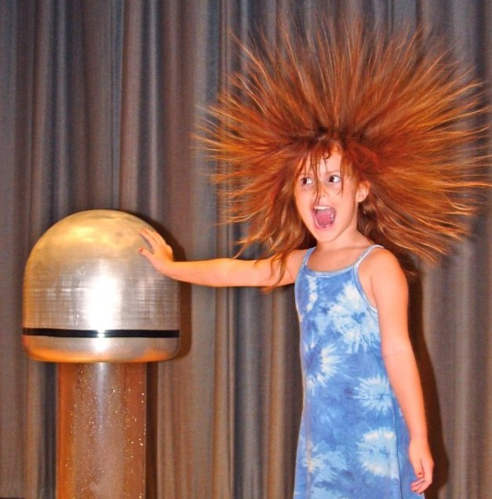
What is Energy?
Notes:
Talk about the Alaska market & primarily going to talk about wind diesel.

Slide 14
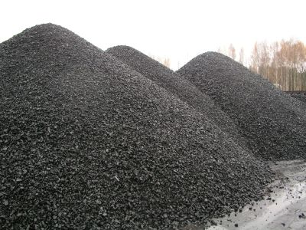
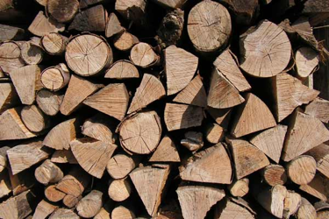


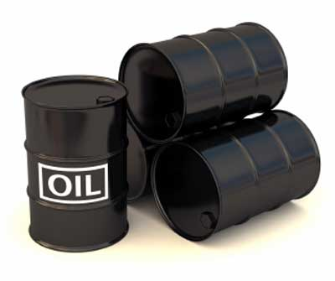
Where does energy come from?
Notes:
Good to think about where it comes from. Used to be wood. But now primarily fossil fuels like coal and oil and what is happening to demand for that.
50% of our electricity still comes from coal. In alaska natural gas and diesel in our outlying communities.

Slide 15
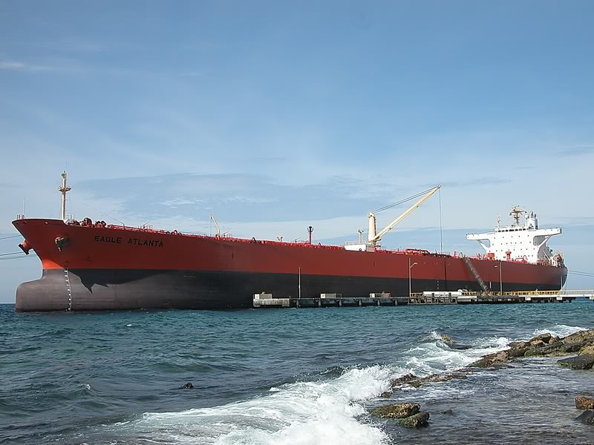
Lots of motivation
High energy costs, $$$s flowing out of state
Notes:
Some villages pay as much as 50 to 90 cents a kwh
Exporting lots of dollars.
Rural Alaskans are spending 30% of their disposable household income on energy cost, $1 billion sent overseas every day for oil
Energy is the original currency
China is on the way up, US is the way down
US uses about 25% of the worlds oil but produce about 4%

Slide 16
Alaska’s Energy Picture
Renewable Electricity Goal 50% by 2025
Renewable Energy Grant Fund – $50 million/yr
Hydro – 21% of Alaska’s electricity
Wind – 20+ communities now powered by wind
  Total installed just over 66MW
    Mostly smaller systems from few hundred kilowatts up to 1MW
    A few larger systems – Eva Creek 24.6MW & Fire Island 17.6MW
Also Geothermal, Biomass, Ocean, In- River Hydrokinetic, and Solar

Slide 17
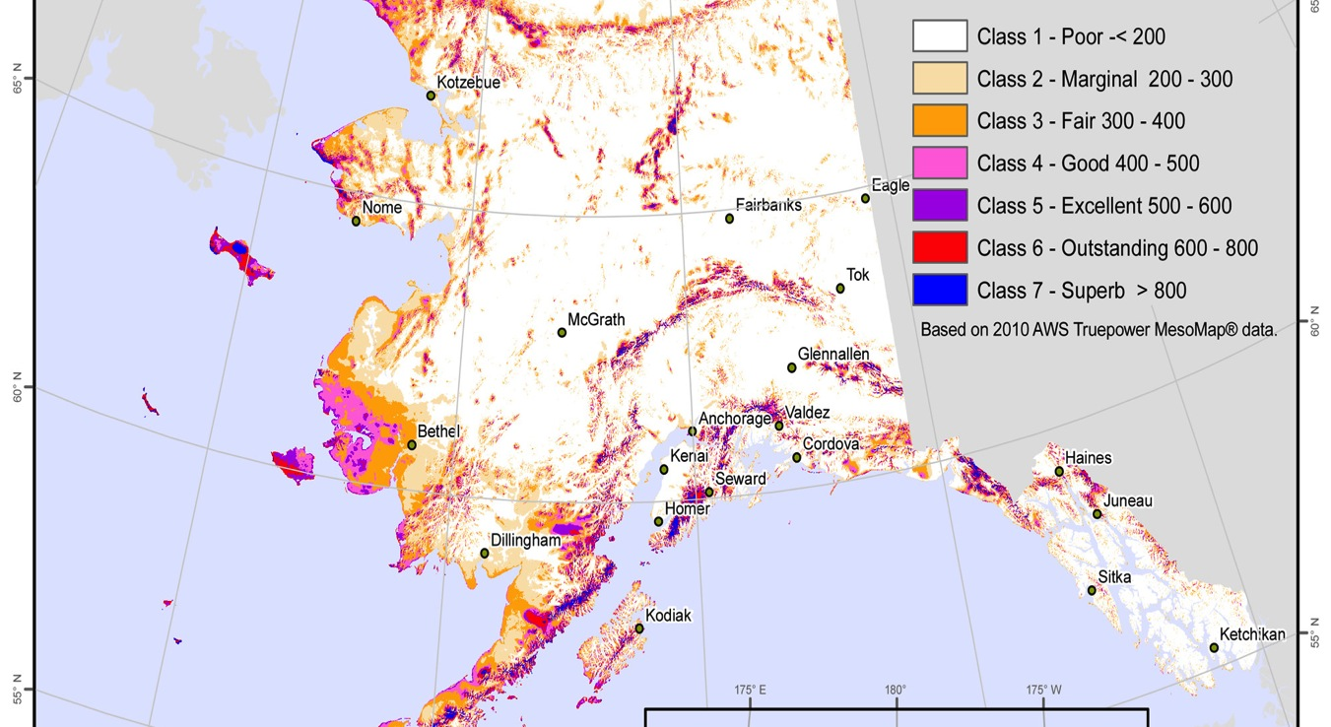
Good Wind Resource
Notes:
Alaska Overview

Slide 18
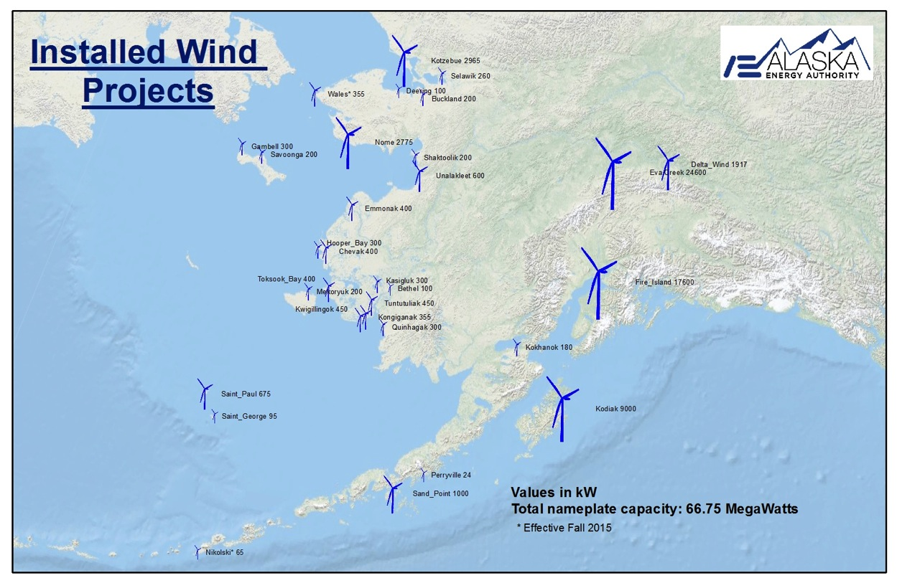
Alaska installed wind
Notes:
Over 20 plus systems now installed. Variety of turbine types and hybrid systems Vestas, EWT, GE, Northwind 100s. Total MW installed

Slide 19
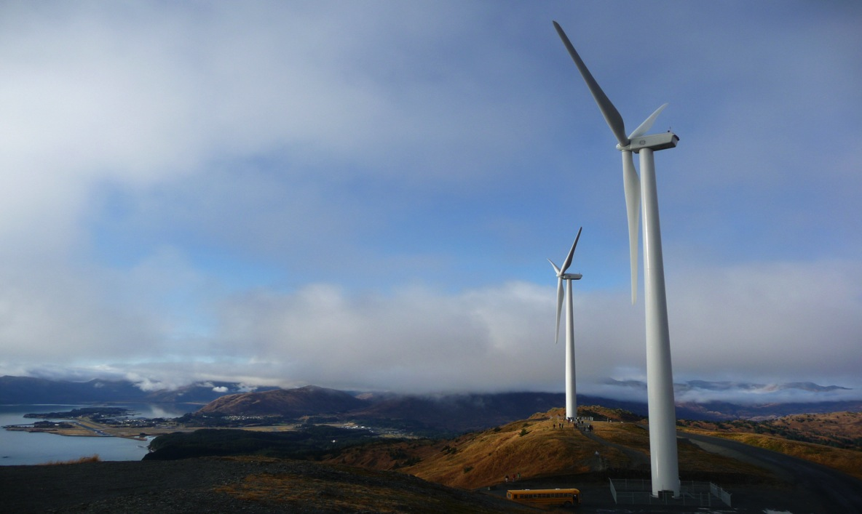
Kodiak Electric Association Wind
99.7% renewably powered – 20% from wind wind-diesel/hydro/flywheel/battery hybrid system
6 GE SLE Turbines • 9 MW
Notes:
GOAL originally to be 95% renewably powered by 2020.
Extensive modellng. Brought in an anemometer beforehand, put in new governors on their hydro plant to get their hydro to respond more quickly, planned their road route

Slide 20
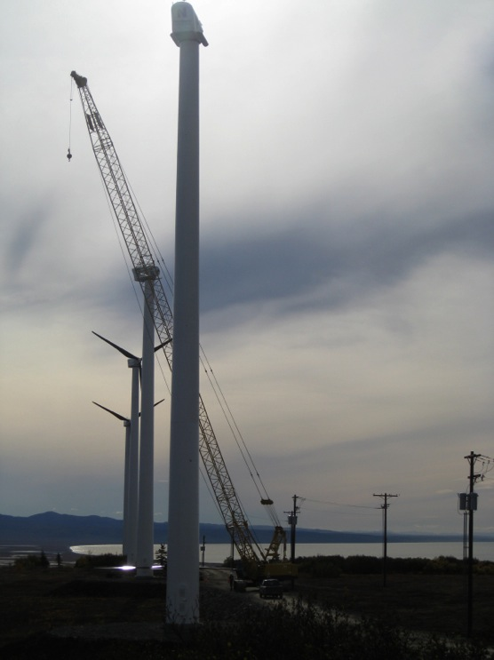
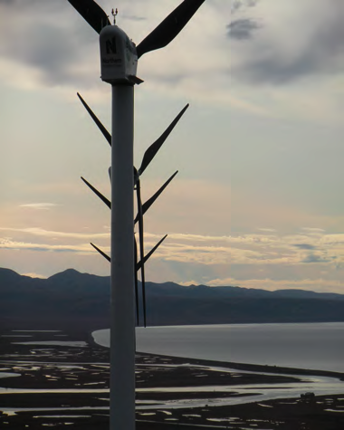
Unalakleet Wind
600 kW • Northwind 100s
Use excees wind for heating public facilities like school and city offices
http://northernpower.kiosk-view.com/unalakleet
Notes:
STG is currently working on integration controls and, pending progress of the plant remodel, should
have all of the secondary load equipment operational by the end of the 2010.
21 mph 68 kw

Slide 21
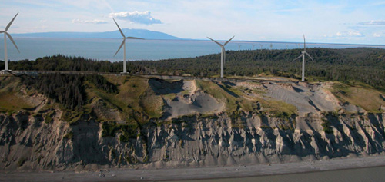
Fire Island Wind
11 GE 1.6MW turbines • 2013
Notes:
11 turbines 17.6 MW
Enough to power 6,000 homes
Online 2013
IPP CIRI Native Corp.
Save 300-500 million cubic feet of natural gas/year – 3-6% of Chugach electric’s annual use
Eva Creek 24 MW..

Slide 22
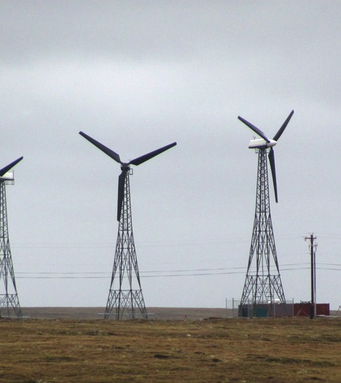
Wind-Diesel Challenges
Remoteness
Small populations
Higher costs
Smaller turbines
Human capacity
Technical issues
Environmental issues
Extreme weather

Slide 23
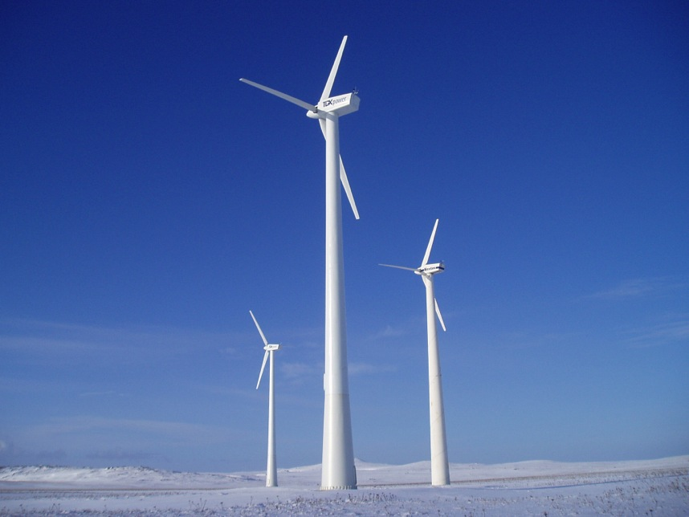
Climate
St. Paul Alaska • TDX Power

Slide 25
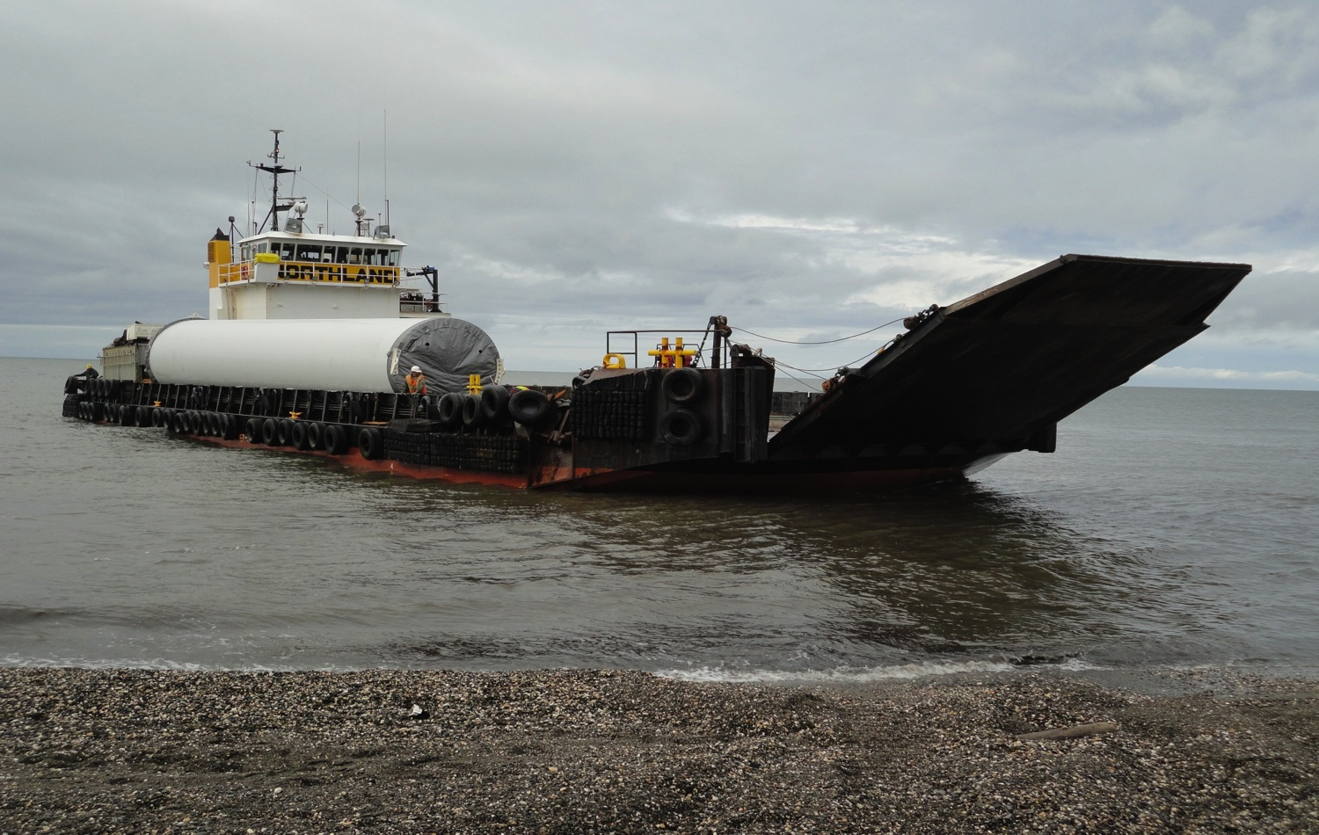
Logistics

Slide 27
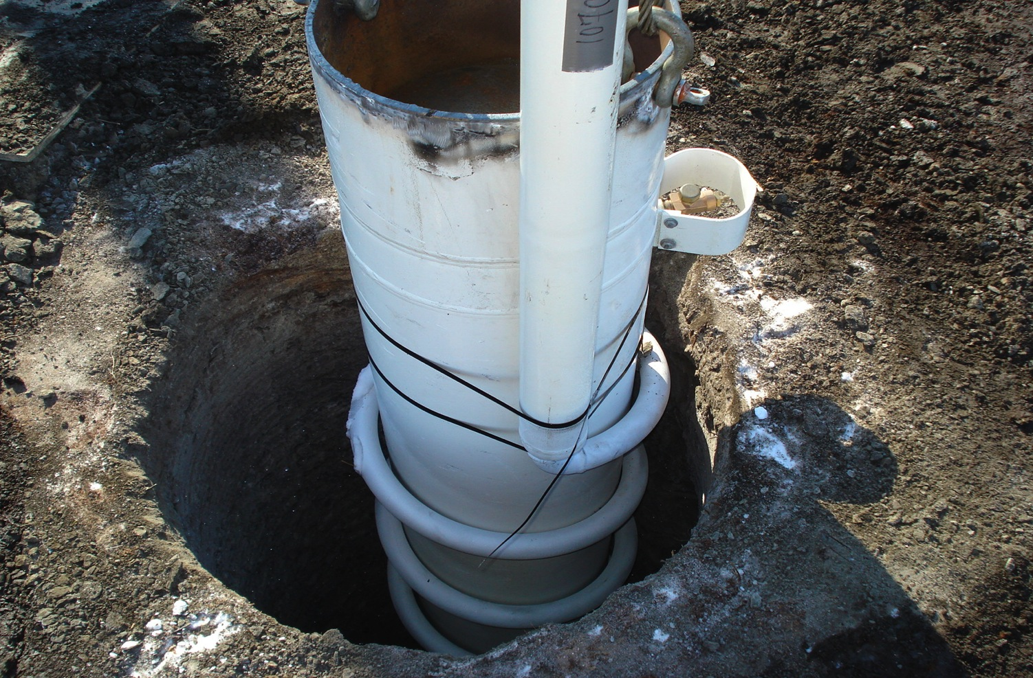
Foundations

Slide 28
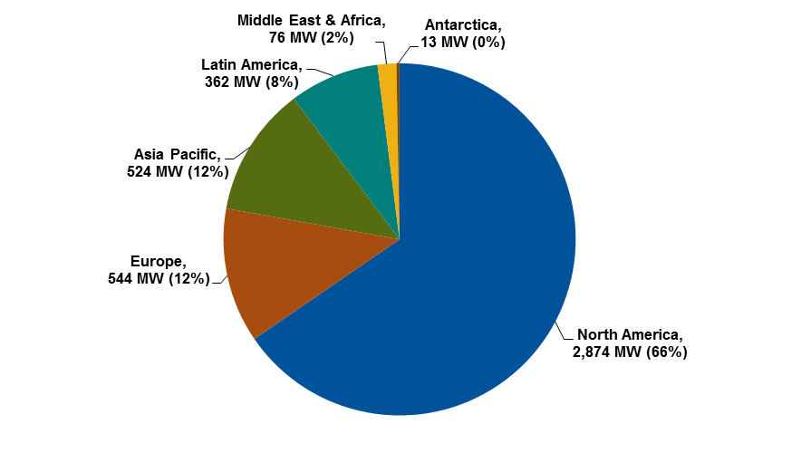
Microgrids: A Global Market
Total Microgrid Capacity by Region, World Markets: 2Q 2014
(Source: Navigant Research)
Notes:
Experts from Russia, Australia, Belgium, Canada, Germany, Alaska

Slide 29
Microgrid Enabling Technologies:
Distributed Generation
DG Capacity Market Share in Microgrids, World Markets: 2014
(Source: Navigant Research)

Slide 30
Microgrid Enabling Technologies:
Vendor Revenue
MET Vendor Revenue Market Share by Technology, World Markets: 2014
(Source: Navigant Research)

Slide 31
Asia Pacific Leads
Remote Microgrid Revenue
Remote Microgrid Revenue, Conservative Scenario, World Markets: 2013-2020
(Source: Navigant Research)

Slide 32
Challenges Still Daunting for Microgrids
Historic anti-islanding bias of utilities
  Worker and equipment safety, obligation to serve,
  and stranded investment concerns
Existing subsidies for status quo
Lack of integrated policies for microgrids
Lack of clear controls technology approach
  No leading go-to player
Business models unclear
How can the reliability, economic, and eco benefits that flow from microgrids be quantified by regulators?
(Source: Northern Power)
Notes:
* human capacity
* energy storage
* financing (business models)

Slide 33
Stephanie Nowers
Islanded Grid Resource Center Facilitator
Anchorage, Alaska
www.islandedgrid.org
sjnowers@mtaonline.net

Slide 34
Trevor Atkinson
Technical Sales Support Manager
Sr. Applications Engineer
Northern Power Systems
Barre, Vermont

Slide 35


Hybrid Wind-Diesel Microgrids
Trevor R. Atkinson,
Technical Sales Manager / Application Engineering
04-16-2015 DWEA
Notes:
Thanks for inviting me and everyone for attending & supporting this important discussion.

Slide 36
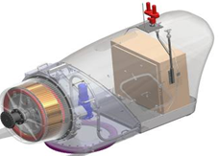
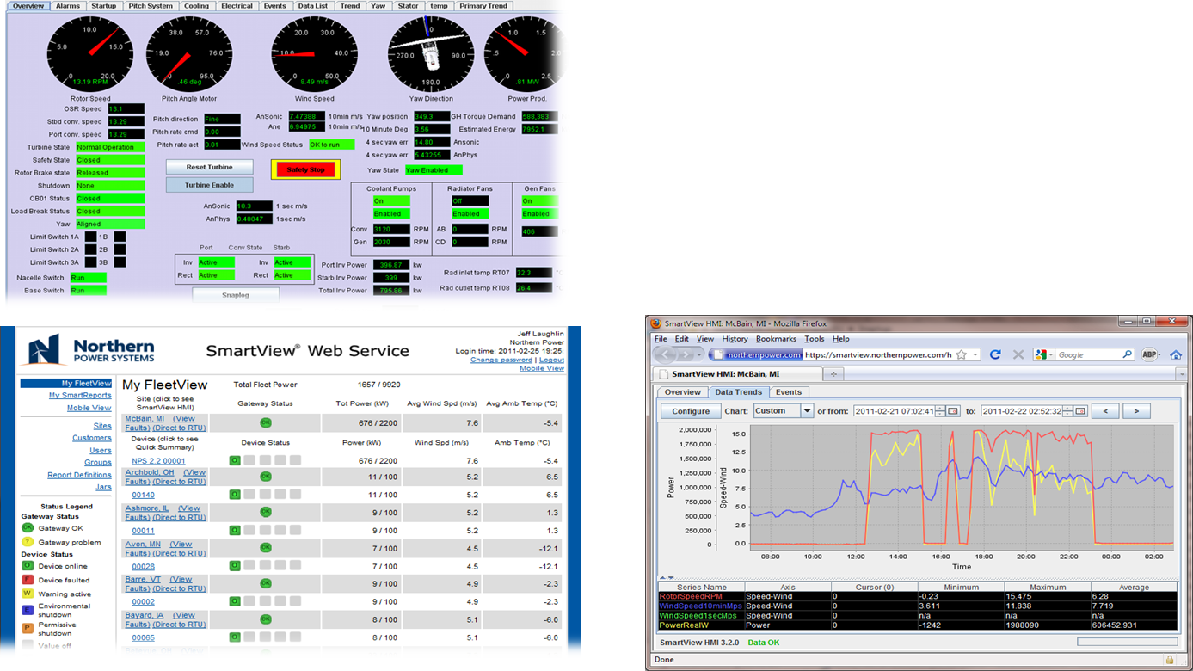
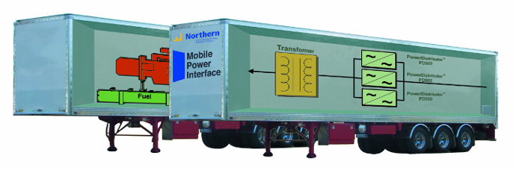
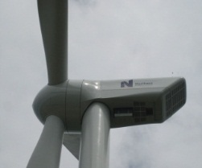
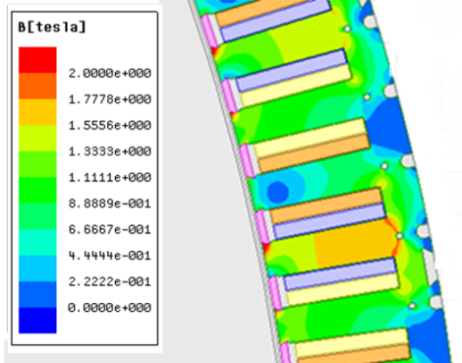
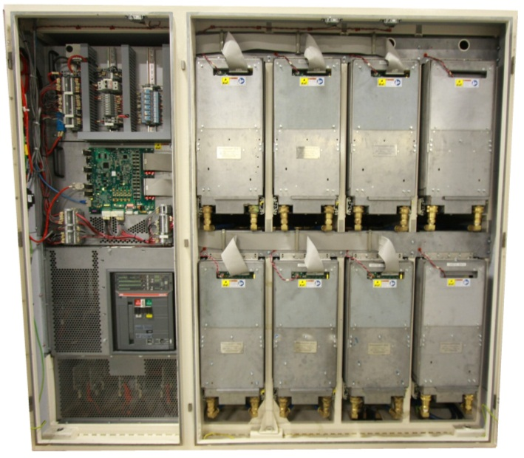
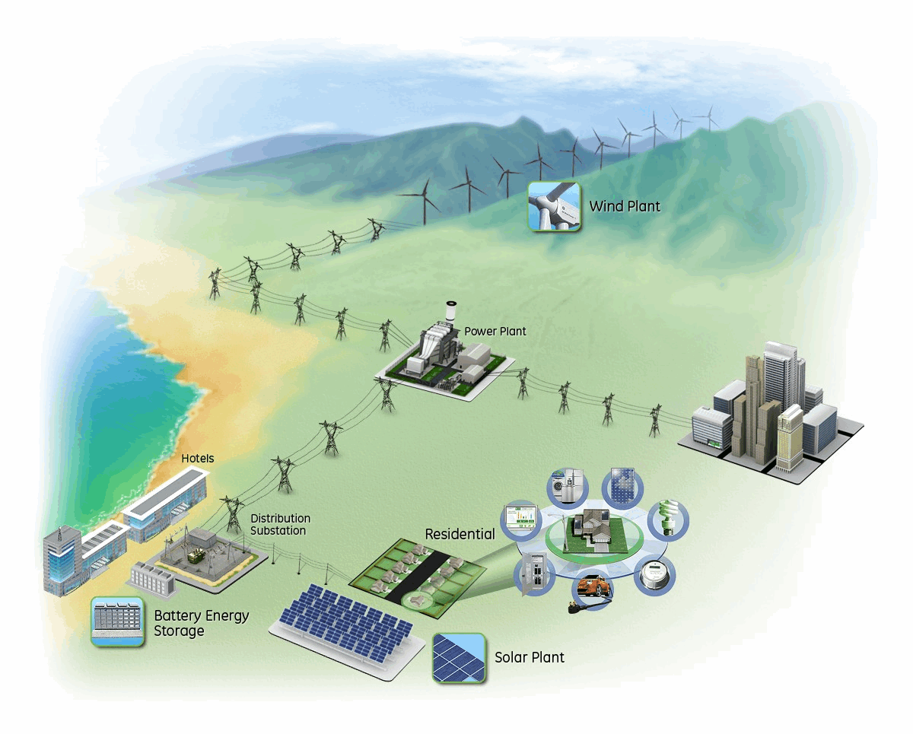
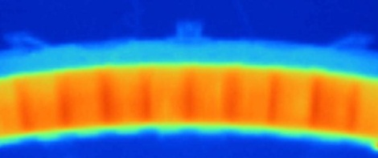
Northern Power Business Lines
Product Sales & Service
Technology Licensing
Technology Development
NPS 100kW
NPS 60kW
High-margin Engineering project work
Expansion of IP portfolio
Licensing and Royalty Model
Successfully deployed
in China and Brazil to date
NPS 2MW turbine
platform
Converter and
Controls Systems
Distributed Turbine Sales
~3x 2012 to 2014
BRIC+ strategy
Today in Growth US / EU
Notes:
Northern Power has three separate business lines that all complement one another, though our primary focus is our permanent magnet direct drive wind turbine business.
Selling turbines directly,
Licensing our technology, and
High value partnerships, developing innovative technology in our sector
Product sales drive our core revenue growth (3X+ growth); but we aim to contract manufacture and focus on sales and intimate customer support – we are about the high value of the technology
Licensing and development is a focus on strategic partnerships that bring strong profit and cash flow along with expanding technology

Slide 37
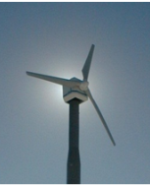
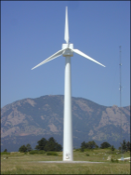
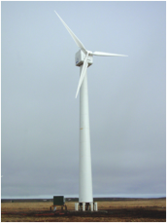
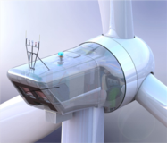
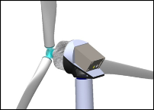
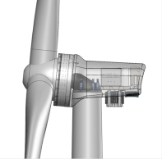
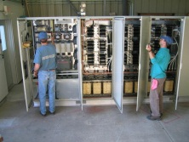
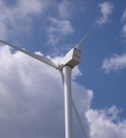
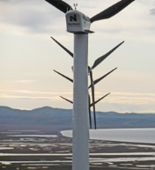
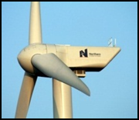
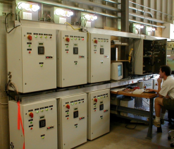
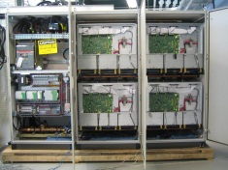
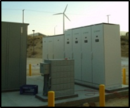
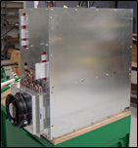
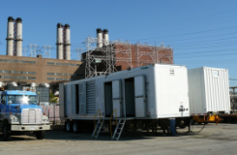
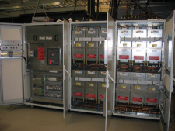
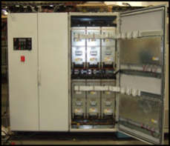
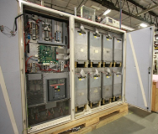
Wind and Microgrid IP Development
100 kW POC
(1)
100 kW DWT (1)
2.x MW Prototype
(2)
2.x MW
Production
(30+)
NPS 100C
(50+ & counting)
100 kW CWT
(3)
NW 100A (20)
Wind PACT
1.5 MW
NPS 100B
(430+)
3.x MW
Prototype
1999 2000 2001 2002 2003 2004 2005 2006 2007 2008 2009 2010 2011 2012 2013 2014 2015….
45 kVA micro grid simulators (8)
2.2 MVA
POC wind converter
550 kVA
Ultra-Cap
Line interactive UPS
900 kVA
DG Interface
1800 kVA
Mobile DG
interface
2.5 MVA
HS-VFD (2)
1.2 MVA
HS-VFD (2)
900 kVA
VSG (16)
Notes:
For almost 40 years now, Northern Power has rebuilt, designed, and manufactured wind turbines from our headquarters in central Vermont
Especially notable developments related to our 100 kW distributed wind turbines:
POC = proof of concept 100 kW turbine, demonstrating an all-new direct drive wind turbine architecture 15 years ago… installed near our factory
CWT = Cold Weather Turbine, designed for Antarctica, installed in AK… installed in 2001 and still operating today
Commercialized 100 kW in 2002—100A … virtually all went to isolated hybrid microgrids in AK
Second-generation 100B in 2008
Power converters for line protection, utility interconnection, UPS, & microgrids from 2002
Third-generation 100C in 2014
Notable microgrid and power converter milestones
Microgrid simulators in 2002, resulting from several years of research and development
All MW-level power converters build on architecture & design of smaller-scale 100 kW
Northern Power has over 30 patents related to wind turbines & microgrids

Slide 38
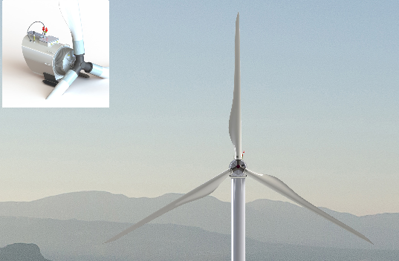
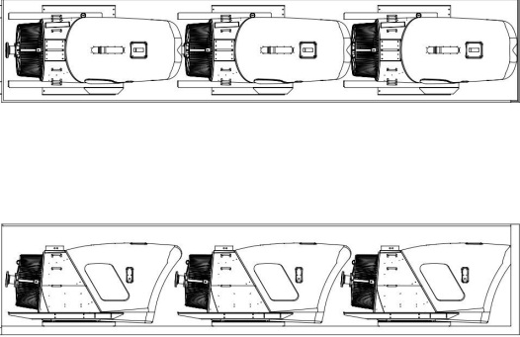
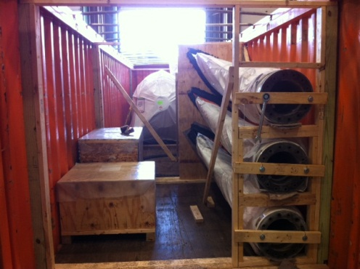
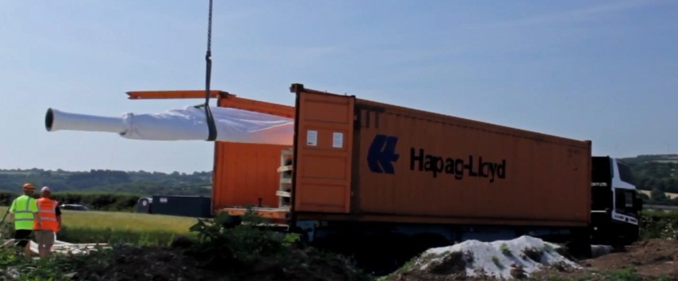
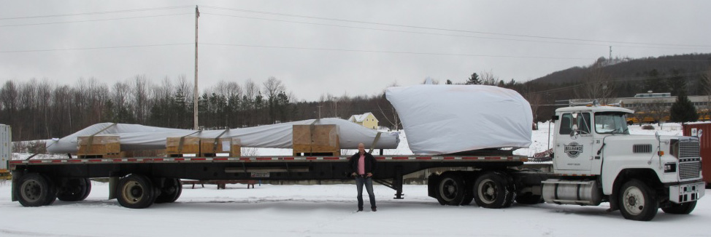
Suitable for Isolated Island & Remote Applications
Easy Transport
  Standard Shipping, No Special Permits
Flexible Features
  Active & Reactive Power Limiting as a
  Function of Voltage or Frequency
  Full Rated Power Converter
  Multiple Rotor & Tower Options,
  Custom Colors and Arctic Versions
Notes:
Transport
No special permits, neither over-size nor over-weight
Hydrophobic coating
Will not PREVENT icing—Mother Nature can always make conditions worse—but will reduce the strength with which the ice binds to the surface
Making them black also helps… whatever small solar gain might be available will help shed the ice
Output control
Possible because of our full power conversion architecture and our control implementation
Real power can be limited on command from an outside controller
Automatically create reactive power to manage voltage at turbine connection
Automatically limit power output as V increases… ride through voltage sags, LVRT, to support grid stability
Automatically limit power as frequency varies…

Slide 39

NPS Global Footprint
Over 450 NPS Turbine Systems Installed Worldwide
Strong installed W-D base in Alaska, new growth in Korea, Caribbean & HI Islands
Poised to take Distributed Wind to Emerging Markets
Markets in Island Nations, Latin America, South / Central / East Asia, and Africa characterized by:
  High power costs
  Weak grid infrastructure
  Desire for more sustainability and independence
Notes:
Northern Power turbines are already broadly deployed & suitable for a wide range of applications
Islands (withstood hurricanes in Caribbean),
remote villages (Alaska harsh climate & wind regimes),
schools (safe and quiet),
cities (small / unobtrusive / of a scale with other familiar structures),
distributed wind farms,
prototyped in repowering / retopping of distributed-class wind farms
Two utility-class units flying; well over 100 MW of new turbines are planned for production in next 18 months

Slide 40


Understanding W/D Microgrid Issues
Diesel Load Profile
Wind Contribution
  Low
  Medium
  High
Integration
Considerations
  Load Characterization
  Frequency & Voltage
  Ride-Through Req.
  Diesel Controls
  Excess Energy Usage
  Economics
Notes:
Probably Most Important Single Issue
Power Plant Sized for Maximum Load + Growth
Running at low load is less efficient
Smaller genset lowers low-load threshold
Average Only Goes So Far
Not so concerned with highs
Need to understand lows & duration
Use Simulator (HOMER, RETscreen, etc.) to Estimate Required Energy Flow/Storage requirements
Find/Use Dispatchable Loads
Irrigation or water tank pumping
Distributed heating/Cooling elements or Central Electric Boilers
Water treatment / filtering / RO / Ice, etc…
Heating fuel generally not as valuable as generating fuel
Electric Vehicle / Transportation re-charging
----------------------------------------------------------------
Turbine Siting Requirements (site class?)
Evaluate Turbine Energy Contribution
Curtailment Requirements ?
Tower / Tip Height constraints ?
FAA issues ?
Flicker / Acoustic concerns ?
Environmental ?
Service / Access ?

Slide 41
Key Issue: Characterize the Load
Probably Most Important Single Issue
Power Plant Sized for Maximum Load + Growth
  Running at low load is less efficient
  Smaller genset lowers low-load threshold
Average Only Goes So Far
  Not so concerned with highs
  Need to understand lows & duration
Use Simulator (HOMER, RETscreen, etc.) to Estimate Required Energy Flow/Storage requirements
Find/Use Dispatchable Loads
  Irrigation or water tank pumping
  Distributed heating/Cooling elements or Central Electric Boilers
  Water treatment / filtering / RO / Ice, etc…
  Heating fuel generally not as valuable as generating fuel
  Electric Vehicle / Transportation re-charging
Notes:
Common Fact: ~1 kw-hr electricity requires ~$0.36 of fuel assuming $1/L cost, Burning Heating fuel for same 1 kw-hr of heat (x,xxx btu’s) requires ~$0.17 of fuel at $1/L cost.

Slide 42

Typical Hybrid W/D Microgrid System 1-Line
Notes:
Includes renewables… storage… diesel gensets… secondary loads…
…and a microgrid controller… primary difference between a microgrid controller and, for example, a diesel power plant controller is that the microgrid controller works with smart components… it does not command behavior, it rather sets constraints & smart components manage themselves to operate within those constraints… perhaps a subtle difference, but very important…
Northern Power provides more than just a wind turbine in this system… we can provide also the smart inverter from the DC bus that manages flow from the PV array and to & from the batteries… and the microgrid controller…

Slide 43

Old W/D Penetration Classes
Notes:
Back in the day it was much simpler, and we have learned much through the years.

Slide 44
Large Village Load Demand: One Day
Notes:
A hypothetical daily demand profile
a good-sized village,
maybe a thousand residents &
some small commercial & industrial demand
Note:
Low point during the night,
Rising during the morning to a relatively consistent maximum demand during the day, and
Dropping in the evening…
In an isolated village, this is what a diesel power plant does—the diesel gensets “follow the load,” providing exactly enough power to satisfy the demand.
Lay energy production from a 100 kW wind turbine over the demand… clear that the wind contributes a small portion of the total need
(Incidentally, this production chart is from an actual wind storm that an NPS 100 experienced in 2011 in Vermont.
Note the ramp up during the morning as the storm rolls in.
Also note the wind turbine disconnecting when the wind speed got too high…
…and reconnecting when the wind dropped a bit.)
The red line shows the difference between the demand and what comes from the wind…
This is what the diesel plant provides
No longer strictly “load following,”
Rather “difference following.”

Slide 45
A Smaller Village
Excess Wind Energy
Notes:
Look at a smaller village with the same wind regime…
Again, the diesel plant follows the DIFFERENCE...
Note times with not enough demand or
Too much wind
AND
Gensets operating at very low load—well below 25-30% of rated…

Slide 46

Things to Notice
Wind & Load Follow Different Patterns
  Wind Energy follows the wind speed
  Generators follow the DIFFERENCE between load & wind power
Too-low Load or Too-high Wind Can Cause
Excess Electrical Capacity & System Stability Issues
  What to do?
    Turn off wind turbines
    Divert energy to secondary load
    Reduce wind turbine output
Nature of Load is Crucial
  Understand minimum demand
  and period

Slide 47

Low-contribution Systems
Maximum Wind < ~60% Minimum Load
Diesel Gens Always Run
Estimate AEP From Power Curve and Wind Speed
No Special
Equipment or Controls
Grid-connected Is
Low-contribution

Slide 48

Medium-contribution Systems
Maximum Wind < ~90% Minimum Load
Diesel Gens Always Run
  Sometimes slightly lower than recommended… to ~10% of capacity
  Low-load operation can cause genset troubles
Power Quality Issues at Low Load
Secondary Load
  Fast-switching
  Resistive
  Separate controller
Notes:
Low-load power quality from limits on what a reciprocating diesel engine can physically do when operating with little load

Slide 49

High-contribution Systems
Maximum Wind > ~90% Minimum Load
Diesel Gens May Not Run
  May turn off for short times
Secondary Loads Are usually REQUIRED
  Need a valued use like heat
Generally Requires Electricity Storage
  Batteries
  Flywheels
  PCS/BES
Estimate Electricity Storage
Needs From Simulation
  HOMER (NREL)
Controls Can Be Challenging
Notes:
Once you reach high (80-90, or 100%)% of contribution, load management is critical to system performance and stability.
Common Fact: ~1 kw-hr electricity requires ~$0.36 of fuel assuming $1/L cost, Burning Heating fuel for same 1 kw-hr of heat (3,412 btu’s) requires ~$0.17 of fuel at $1/L cost.

Slide 50

New and Improved W/D Penetration Classes
Notes:
What’s key is Inst. & Average levels are quite different and can be wildly variable.

Slide 51
Conclusions / Lessons Learned
Many options to consider, all sites are different!
- Low Penetration – Fairly easy with minimal fuel savings.
- MP – More complex, likely will require SLC/DL of some type.
- HP - Very complex, more costly, but can meet ROI/fuel saving goals with quality equipment and solid detailed design.
Tons of COTS equipment is available, but requires skill & experience to create a reliable fuel savings solution.
To achieve good power quality and system performance will require constant O & M just like any advanced machine/system.
One-offs are a nightmare, repeat, (what works), repeat……is key!
Wind Turbines are like any power plant, choose quality reputable experienced manufactures who support their product.
Leverage the organizations whom have proven experience, this is not rocket science, don’t try to reinvent the “wheel”.

Slide 52
Terms /Glossary
Min. Engine Load, Wet Stacking
Energy Storage (Chemical, Mechanical, Potiental)
Wind Penetration (High, Medium, Low) Inst. & Ave.
WTG Curtailment, Capacity Factor, Power Curve,…
Secondary Load - Dispatch / Deferrable loads
Thermal loads, Engine cooling loops, Electric Boilers
Stochastic, Fast & Slow Load response
Synchronous Condenser, VAR Compensation, Lead/Lag
SCADA , Remote Monitoring/Access, Controls, Com Network
Diesel Engine Controls (Mechanical or Digital), Synchronization, Phase imbalance, Reactive Power, spinning reserve (seconds), Standby Power (Minutes-to-Hrs.)
Power Quality, Voltage / Frequency / Power Factor
Modeling: Financial, Electrical, Mechanical, operational,…
Notes:
No order, just be aware of what you know and don’t know….

Slide 53
Extra Credit (Time Permitting):
Case Studies of some selected NPS Wind Diesel Systems

Slide 54



Alaskan Fleet (A & B Units)
40 NPS 100kW Turbines Flying
Millions of Gallons of
Diesel offset!
Kotzebue
Emmonak
Toksook Bay
Quinhagak
Kasigluk
Mekoryuk
Hooper Bay
Savoonga
Seward*
Chevak
Gambell
Unalakleet
Buckland
Deering
Bethel
Delta Jct.*
> 95% Turbine
Availability !!
>50,000 MWh Generated since 1999, some machines operational for >10 Years!
Notes:
Northern Power Experience:
40 NPS 100kW Turbines Flying
>50,000 MWh Generated since 1999, some machines operational for >10 Years!
Millions of Gallons of Diesel Fuel Saved
> 95% Turbine Availability !!

Slide 55

Buckland Electrical 1-Line Schematic
Notes:
Example of AK W-D system Upgrade.

Slide 56


Slide 57


Over Yonder Cay
Ultra-high Contribution
  90% - 100% renewable
  96-98% energy from WTG & PV
  375 kW PV array
  3x 100-21 Wind Turbine
  6 MWh VRLA BES
  3x 250 kW diesel backup
  2x 300 kW PCS - HPC
Hurricane Resistant (Irene & Sandy)
Key success factors
  Simplicity & dedicated support
  Swift Service response
  Microgrid control experience
  97% Availability w/6.9 m/s recorded
  2,189,630 kw-hrs of wind energy as
  of 4/2015, ~4 years of operation
Two NPS 100 turbines
on Over Yonder Cay
in the Bahamas

Slide 58

OYC Energy Flow GUI

Slide 59

System 1-Line Schematic

Slide 60

Ramea Island, NFLD, Canada
Customer: NFLD Labrador Hydro
Medium penetration (30%-60%)
400kW-1000kW base load (mostly residential)
3x NPS100-21 Wind Turbines
3x 900kW diesel engines
6x hydrogen fuel gensets
>1,000 MWh delivered to date
Notes:
Newfoundland Labrador Hydro (Can Gov Owned) Medium Penetration (30%-60% wind) Logistics were challenging, poor remote comms, Gov. R & D project
400-1,000 kw base load serving mostly residential loads 3x - NPS 100A (installed 08,2009) 6x - V17 or V19 WTGs (refurbished) 6x - 45 kw Hydrogen fueled Gensets 3x - 900 kw Caterpillar Diesel Gensets No battery storage or PV
~800 MW-Hrs. of wind energy delivered

Slide 61



North Kohala, HI
Customer: Kohala Makani Wai LLC
1x NPS100-21 Wind Turbine
1x 50 HP Submersible Pump/VFD
Wind Following Microgrid Controller
(from Sustainable Power Systems LLC)
200 KVA ABB Power Converter/Inverter
“Plug” for Aux. Diesel Generator
Avg. Annual Wind Speed: 6.1 m/s
Temp Range: +20°C – +25°C
Diesel Consumption: None
System operational, but waiting for
more irrigation load.

Slide 62

Kohala, HI 1-Line Schematic

Slide 63


San Nicolas Island, CA, USA
Customer: Naval Base Ventura California
Expected completion: 2016
High penetration W/D
7x NPS 100-21’s
140 kW SLC
600 kVAR
Synchronous Condenser
500kVA-1000kW flow
battery storage (proposed)
Custom control/dispatch system
5MW diesel gen capacity

Slide 64

San Nicolas Island, CA 1-Line Schematic

Slide 65


(Gasa-do) Island, South Korea
3x 100 kW & 1x 200 kW Diesel Engines
380/6.9KV T & D Network / Transformer
4x NPS 100kW Wind Turbines
PV – 20kW DC, 125 kW AC Connected
(BES) 3.0 MWhr VRLA
(PCS) 2x 250 kVA Bi-directional
Island Load: 160 Households, WWTF, Stone Quarry
~100 kw Ave.
~200 kw Peak

Slide 66

Gasa-do 1-Line Schematic

Slide 67
Ian Baring-Gould
Senior Engineer & Manager in Renewable Energy
NREL
Boulder, Colorado

Slide 68

Wind–Diesel, Status of the Market
Supported by the U.S. Department of Energy
E. Ian Baring-Gould
April 2014
Photo Credit: Northern Power Systems

Slide 69
Range of Power Systems
Renewable power system can be used to cover a wide range of needs, including:
Dedicated use: Power being used at point source without regulation such as water pumping and ice making.
Small or Simple systems: Power systems for small communities, individual buildings, and dispersed energy needs.
Community Power Systems: Power provided to large communities and isolated loads.
Integrated Systems: Large islanded systems integrating conventional and large scale renewable generation.

Slide 70

Communities on the Verge of an Energy Crisis
Oil spikes & high costs have lead many nations, states, and organizations to look at options to reduce dependence on diesel fuel for power generation
Remote Alaskan villages
Remote Canadian communities
Nations that comprise the Small Island Developing States (SIDS) and Alliance of Small Island States (AOSIS)
  Power costs approaching $0.50/kWh
  Typically 100% dependent on diesel, with very small-scale solar or wind power
Over 1.2 billion people in the world have no access to electricity - More than 85% in rural areas meaning thousands of small, remote, off-grid communities, several reports indicating that these will be best served by isolated power systems (which is new)
Thousands of larger island communities mostly reliant on diesel technology
Notes:
DJH
Examples of communities around the globe that are on the verge of an energy crisis
Currently very dependent on expensive diesel fuel in an unsustainable manner
To begin with a domestic example, Alaska …
There are already on-going efforts in the state, such as …
The partnership we’re presenting today aims to compliment the ongoing efforts, not at all meant to replace them. We’re working towards the same goal.
70

Slide 71
The Industry is Making Progress
Operating projects in almost every region of the world with technology and business approaches that is pushing the market
St. Paul – High contribution for over 20 years
AVAC Communities – Developing real operating history with low to mid contribution power systems
Chaninik Wind Group – Dispersed smart heating loads, higher contribution
Ross Island Antarctica – Advanced turbine and flywheel control
King Island Tasmania – High contribution using storage and smart grid
Aruba, Galapagos & others demonstrating large turbine deployment
Banner Peak – PPA based isolated wind contract model
Kodiak Island – Wind-hydro facility with battery storage
Coral Bay, Western Australia – Wind, flywheel and low load diesel
Remea – Wind-diesel system with hydrogen storage
Oahu Hawaii – High contribution on large islanded grids
Technology advances are addressing some of the issues
Many advances in demand side management concepts and technology
Power electronics are improving and costs going down
Variable speed and low load operation of diesels becoming more common
Expansions in monitoring and control leading to better oversight

Slide 72
Continued Challenges
Tailored, unique solutions for each community leading to high cost
Customized engineering, equipment, controls, and construction with little uniformity or commonality among systems
Projects based mostly on grant or research based funding
Little precedent for streamlined project financing, component cost reduction, procurement, construction, and operation and maintenance
Very limited funding for technology development (outside of project funding)
Even less funding for follow-up, evaluation, impact assessment, and technology improvement
Limited common terminology or general agreement on even basic terms
No common understanding of accurate performance metrics
No standards or other internationally “accepted” design criteria – hard to get expanded institutional support
No coordinated outreach, targeted industry or users group, or expanded communications network
Systems are underperforming as compared to the modeling
A virtual glass ceiling for high contribution power systems
Low cost of PV is marking it hard for wind to compete in small systems
Notes:
DJH
How do communities currently address this problem via hybrid renewable energy solutions?
Current approaches are often …
This leads to several barriers and hence a continued problem
Getting to the point of standardization
72

Slide 73




Step by Step Improvements…
Continued development technology – no game changers
Expansion of telecom and in the military have increased reliability – but have not really improved the price point for community power
Decreasing cost in wind technology and power converters has improved system economics and reliability, but not really up front costs.
Increased access to renewable resource information very helpful
Smart Grid concepts have a great deal of promises
Expanded testing infrastructure is available to support system development
Design and analysis tools are becoming more advances
Research projects and expanded interest by DOI, DOD and DOS
Notes:
HOMER most specifically..

Slide 74
Sample of Ongoing Projects
Remote Community Renewable Energy Imitative (RCRE):
  Collaboration of NREL, ACEP and CSU funded by DOI to support the development of high RE (wind and solar) contribution power systems on a cost competitive basis
Quality Assurance Framework for Mini-Grids:
  Developing an accountability structure for mini-grids that mimic’s the current utility framework, building market confidence to allow expanded access to capital markets
Green Mini-Grids Africa Facility:
  A ~$100M financing and accompanying technical support facility for the development of renewable based mini-grids in central Africa with a clear focus on a wide range of off grid power systems
Millennium Challenge Corporation / Indonesia Compact:
  ~$600M Compact to reduce poverty through several tracks including the expanded use of renewable energy generation, primarily in remote islanded systems.
Notes:
Other similar activities (on a smaller scale) the Pacesetters fund from USAID/ Ministry and Rockefeller fund in India, the

Slide 75

Paths Forwards…
We know there are many isolated and islanded communities
We know the viability of remote and islanded communities depend on economically viable energy supplies that wind can help provide
We know that many governments, utilities, and organizations are interested…
… but the path to take the market forwards are still unclear.
Notes:
Renewed interest in rural electrification at the multi-lateral level
Expanding number of examples leading to a general acceptance of the technology as a solution
Push for grid parity power favors wind as a prime RE source
Volatility in diesel fuel prices have made people realize that the financial risks of relying on imported fuels
Concerns around climate change are favoring renewable technologies
Green mini-grids is becoming a catchphrase
Growing understanding that pure grid extension is not the solution –
Numerous projects including Sustainable Energy for All, Power Africa, Green Mini-grid Project

Slide 76

E. Ian Baring-Gould
Technology Deployment Manager
National Wind Technology Center & Deployment and Industrial Partnerships
303-384-7021
Ian.baring-gould@nrel.gov
NREL 14927

Slide 77
Questions?

