Slide 1
The Need for Product Qualifications for the Federal Investment Tax Credit (ITC)

Slide 2
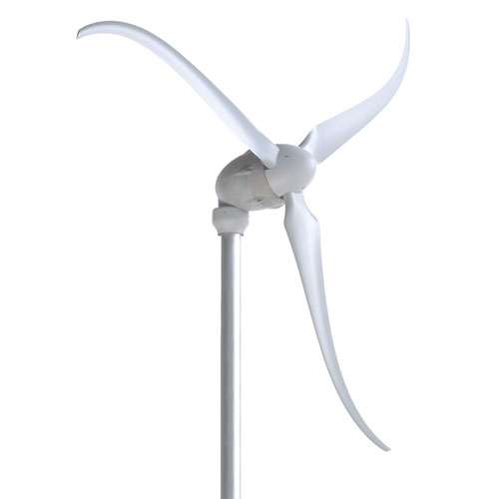
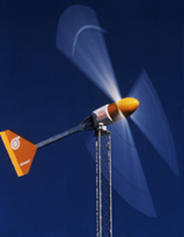
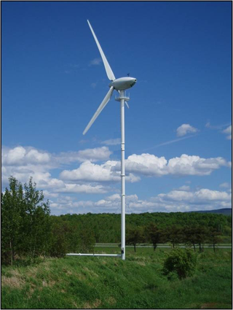
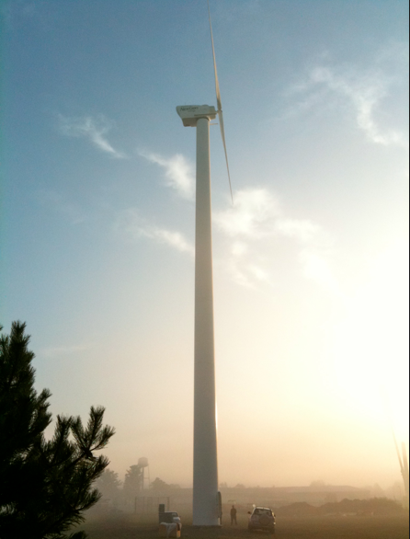
Modern Small Wind Turbines: High Tech, High Reliability, Low Maintenance
Products from 2 – 100 kW
Technically Advanced (Sophisticated & Simple)
Low - Very Low Maintenance Requirements
Track records up to 30 years
North American Companies Lead
2 kW
10 kW
(Not to scale)
50 kW
100 kW

Slide 3
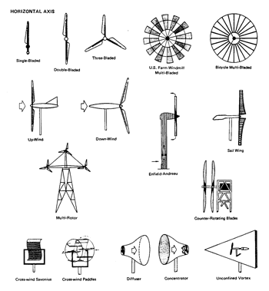
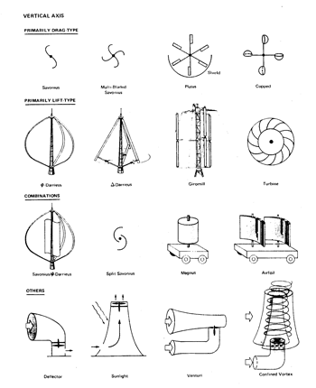
Turbine Configurations
Hundreds of Possible Configurations ... Most can’t Compete
Non-Competitive Configur-ations Keep Showing-up and Attracting Naive Investors:
“Funneling” Flow Concentrators
Diffuser-type Flow Concentrators
Savonius Vertical-Axis Rotors with Electrical Generator
Helical Darrieus Vertical-Axis Rotors
Cloth-Blade, Sail Wings Rotors
Windmill Rotor with Electrical Generator

Slide 4
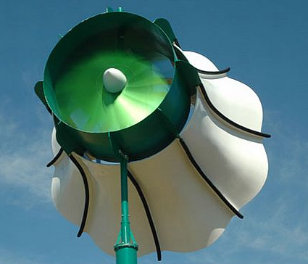
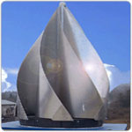
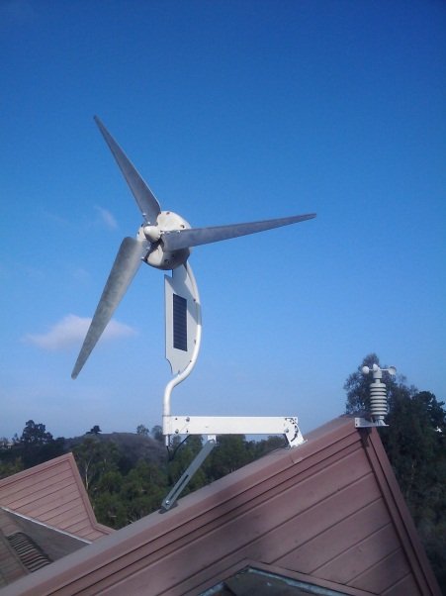
Endless Supply of “Snake Oil” Products
Clueless inventors and unethical opportunists bring dozens of new small wind turbines to market annually
General public wants to believe that there’s been a performance and cost breakthrough; but lack the experience or tools to sort wheat from chaff
For numerous articles and citations, see subcategories at http://www.wind-works.org/cms/index.php?id=17
U.S. Green Building Council LEED, with no wind turbine standards, nurtures fringe products for green buildings

Slide 5
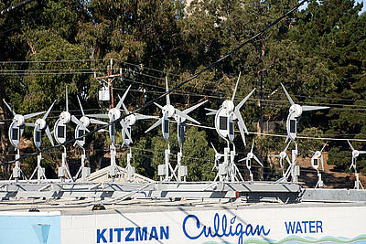
Example: DyoCore
6.5 ft diameter roof-mounted wind turbine built in Southern California
Claimed Rated Power of 1.6 kW at 18 mph – which is 4.5 times the maximum theoretical efficiency
$2,000 product “qualified” for $4,800 California rebate; plus they qualified for the federal ITC … Turbines were sold for $1
CEC shut down their program after receiving > $50M in rebate application in 3 months in 2010
CEC investigation revealed the fraud and they rejected pending applications
Legitimate California industry still hasn’t recovered

Slide 6
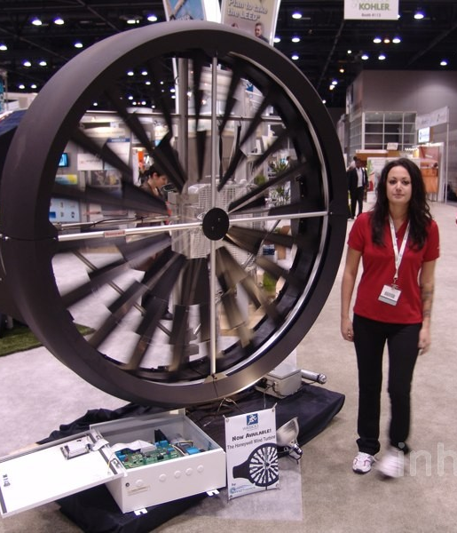
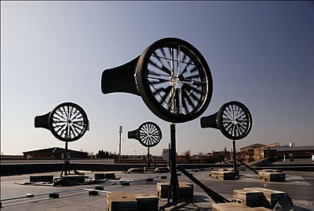
Example: WindTronics
5.7 ft diameter roof-mounted wind turbine built in Michigan and then Ontario
Licensed Honeywell name; 2009 “Breakthrough Product” award from Popular Mechanics magazine
Claimed Rated Power of 1.5 kW at 31 mph – power curve hits 160% efficiency, see http://www.wind-power-program.com/small_turbines.htm
15 month test by Consumers Report produced 4 kWh, 0.3% of projection
Raised >$15M from investors and >$3M from governments
Bankrupt in 2013, leaving thousands of customers orphaned

Slide 7
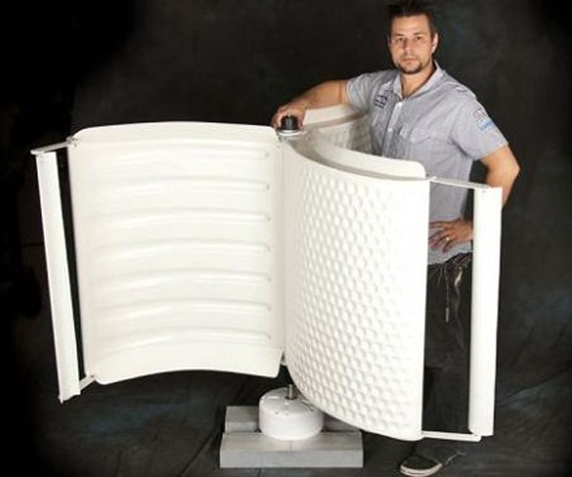
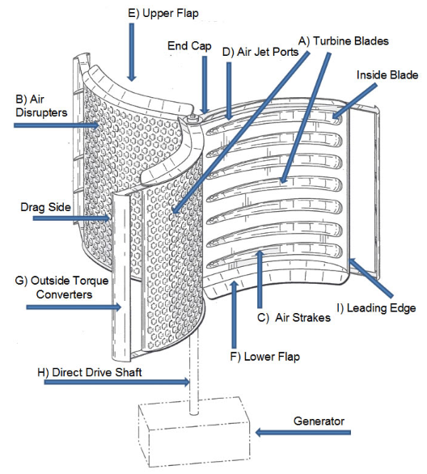
Example: Sauer Energy
3.6’ x 4’ roof-mounted VAWT wind turbine built in California
Current penny stock on OTC BB: SENY.US; sold 92M shares; market cap of $33M with $0 revenues and annual loss of ~$1.4M
Claimed Rated Power of 1.5 kW at 25 mph – which at 69% total efficiency is above the theoretical limit
No independent test data available
Bought assets of Helix, another penny stock VAWT that went bankrupt after raising ~$30M on hyped performance claims

Slide 8
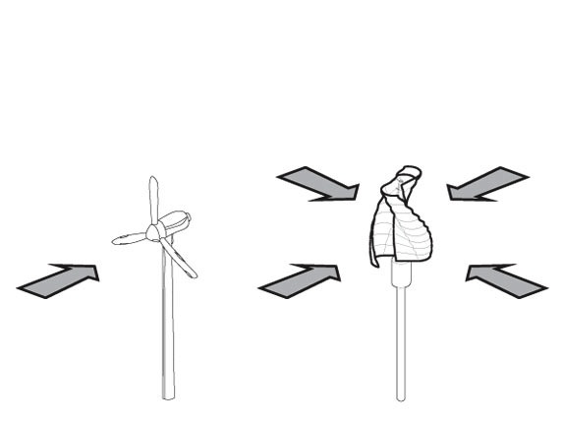
Common False Claims – Caveat Emptor
“50% more efficient that conventional wind turbines”
“Superior because it accepts wind from all directions”
“Works well in turbulence”
“Our technology eliminates the need for tall towers”
“Bird friendly”

Slide 9
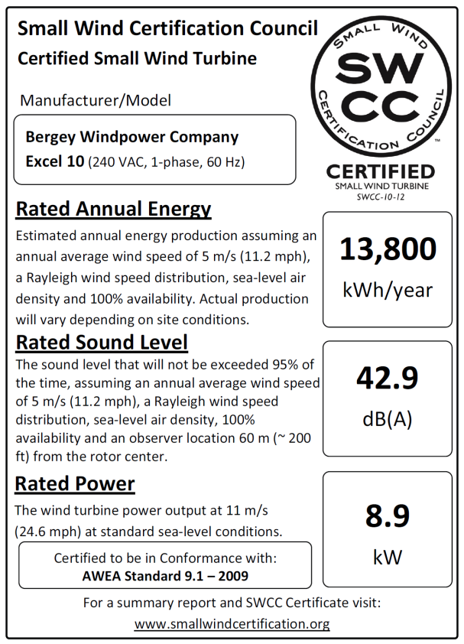
AWEA Certification Standard
Sets Rated Power at 11 m/s (25 mph)
Introduces “AWEA Estimated Annual Energy” modeled after EPA Estimated Mileage for cars
6 month duration test; 90% availability requirement
Detailed structural analyses (based on IEC 61400-2)
Certifications issued by SWCC (smallwindcertification.org) and Intertek (intertek.com/wind/small/)
Standard adopted in UK and Japan

Slide 10
Certification Requirements
New York, Massachusetts, Nevada, and Oregon now require certification to AWEA 9.1. Several other states are in the process of instituting this requirement
The U.K. and Japan require certification to qualify for their feed-in-tariff national incentives
DWEA has developed a set of complementary requirements for turbine above the 200m2 scope of AWEA 9.1; which are also being adopted by states
As of 6/2013 there are 11 models certified in the U.S. 22 models are in the process of certification. Over 20 models are certified in the UK.

Slide 11
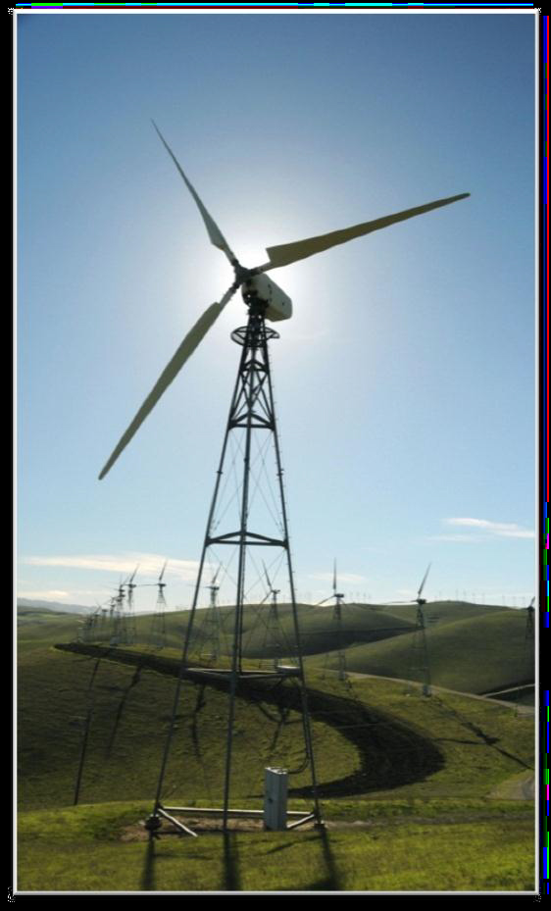
Rebuilt Small Turbines
Over 4,000 1980’s era turbines up to 100 kW are being removed from California windfarms
Several companies, with varying expertise, offer rebuilt turbines and towers for sale, claiming ITC eligibility
These systems previously received federal and state tax credits and depreciation
Need clarification on what is eligible and what is not

Slide 12
DWEA Request: Phase I: Require Certifications to Qualify for Wind Turbine ITC
≤ 200m²: AWEA 9.1-2009 by accredited certification agency
> 200m²: Certified power performance and acoustic test reports by accredited body, plus either certified design evaluation or significant operational experience (e.g., >500K fleet hours & 25 installs & 2+ years on at least 5 units); plus standardized performance reporting
On rebuilt turbines, only new components and re-installation expenses qualify for the ITC

Slide 13
DWEA Request: Phase II: Extend Small Wind Certification Requirements to Other Federal Incentive / Procurement Programs
USDA REAP (DWEA pursuing)
Misc. federal facilities and procurements
Military facilities and procurements
Foreign assistance

