Slide 1
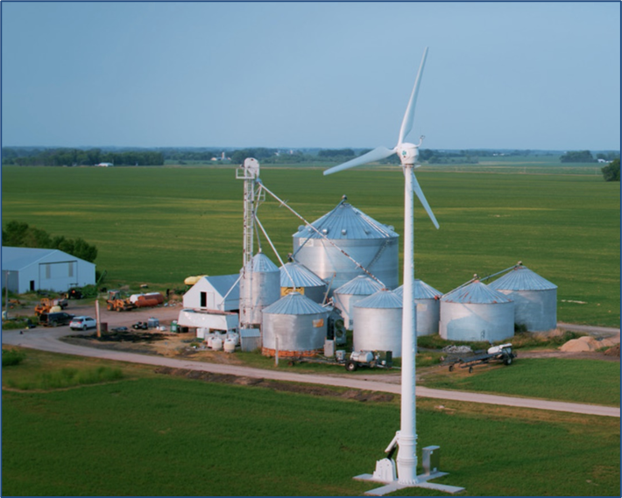
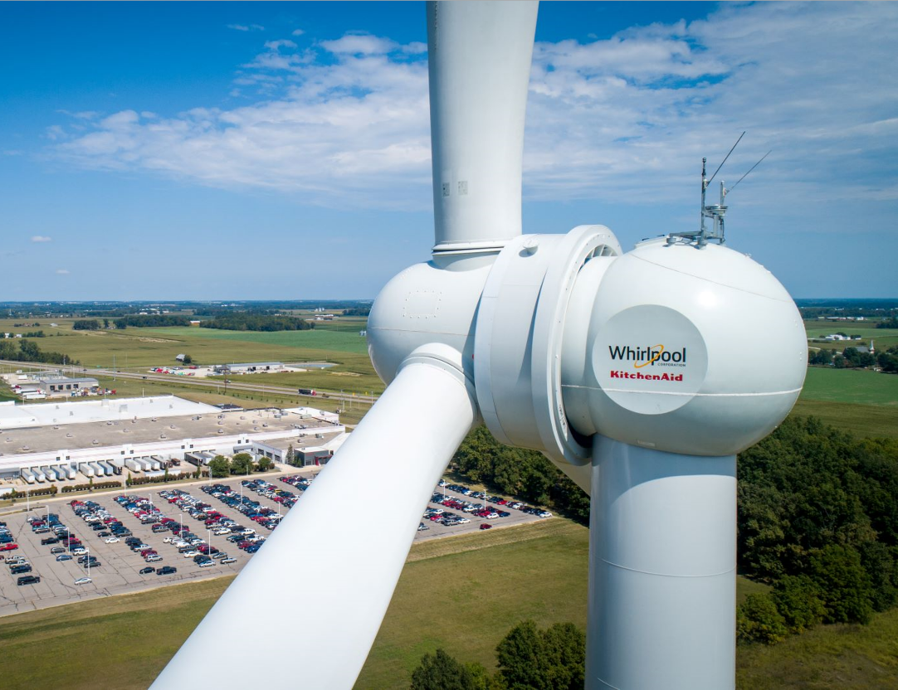
Distributed Wind Energy 101

Slide 2
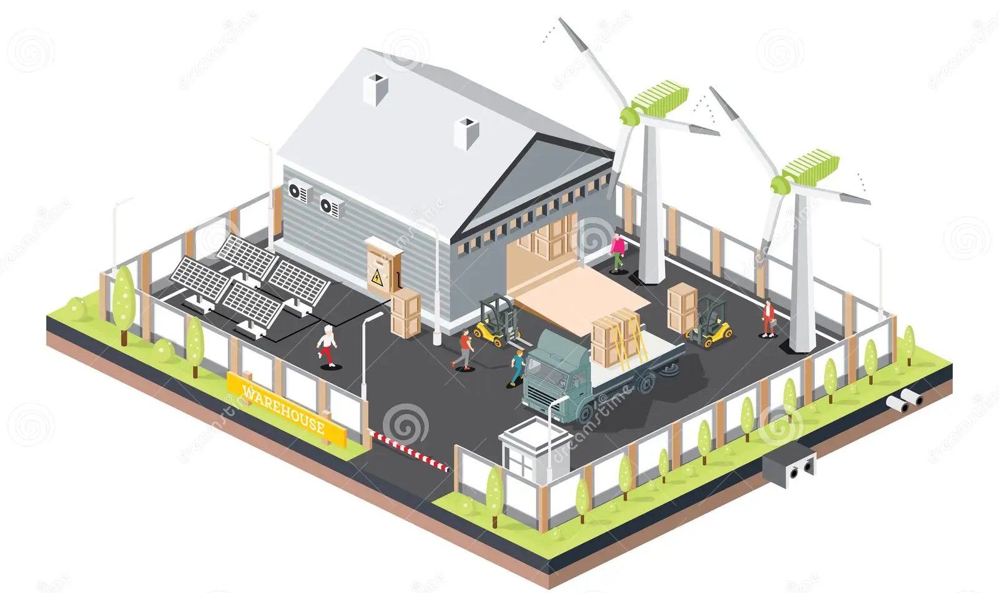
What is Distributed Wind?
The use of one or a few wind turbines at homes, farms, businesses, or public facilities to off-set on-site energy consumption (behind-the meter). Lowering operating costs.
Wind energy produced first
serves the local load
and any excess is
sold to the utility
No back-up Power
during utility outages
(w/o storage & special electronics)

Slide 3
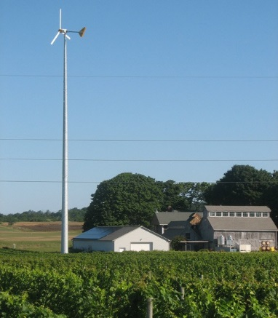
Benefits of Distributed Wind
Least-cost renewable technology in areas with good wind resources
Small footprint compared to solar
Leverages America’s technology and manufacturing strengths
Complements solar; reduces need for storage and back-up

Slide 4
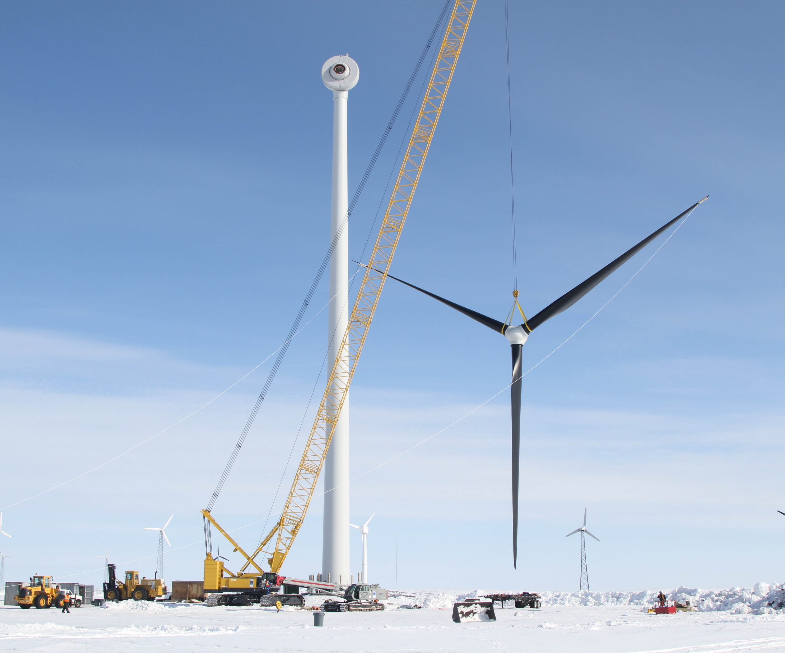
Benefits of Distributed Wind
Strengthens the grid and promotes resilience
Ramps faster than some other clean energy technologies
Provides branding for environmental stewardship

Slide 5
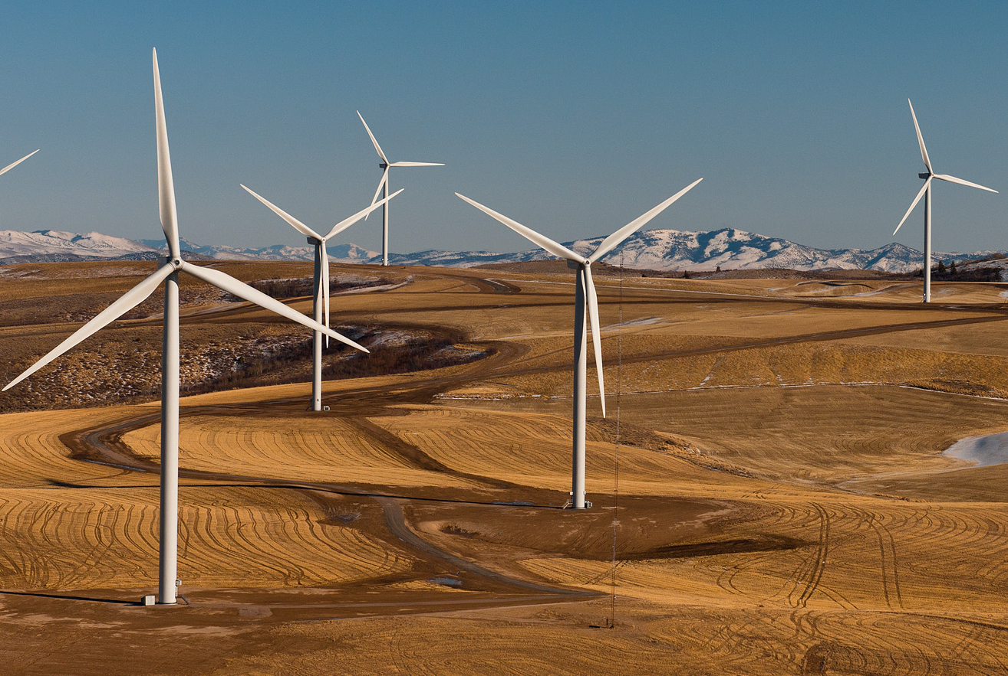
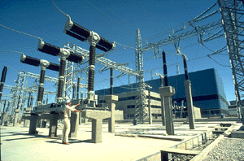
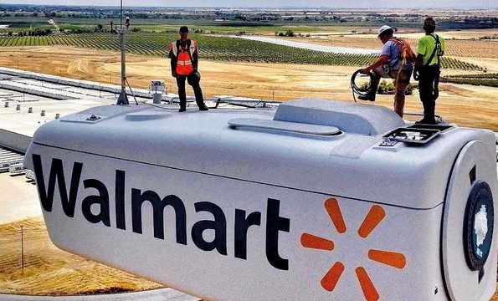
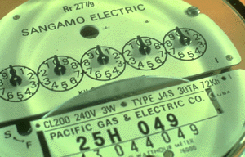
More Expensive, but also More Valuable
Windfarm Turbines
  ~ $1,500 / kW
  Providing Wholesale
  Power, sold at:
2 - 4¢/kWh
Distributed Turbines
  ~ $3-9,000 / kW
  Providing Retail Power, sold at:
8 - 42¢/kWh

Slide 6
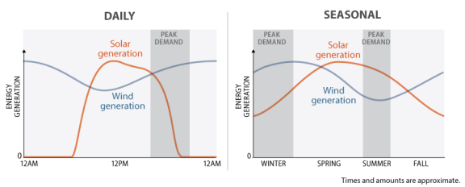
Wind and Solar are Complementary Energy Sources
Source: Congressional Research Service

Slide 7
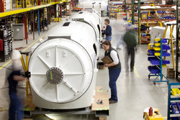
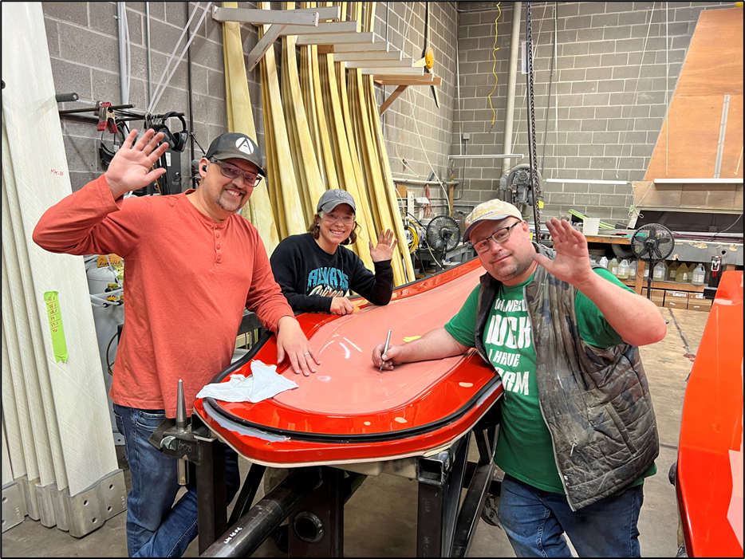
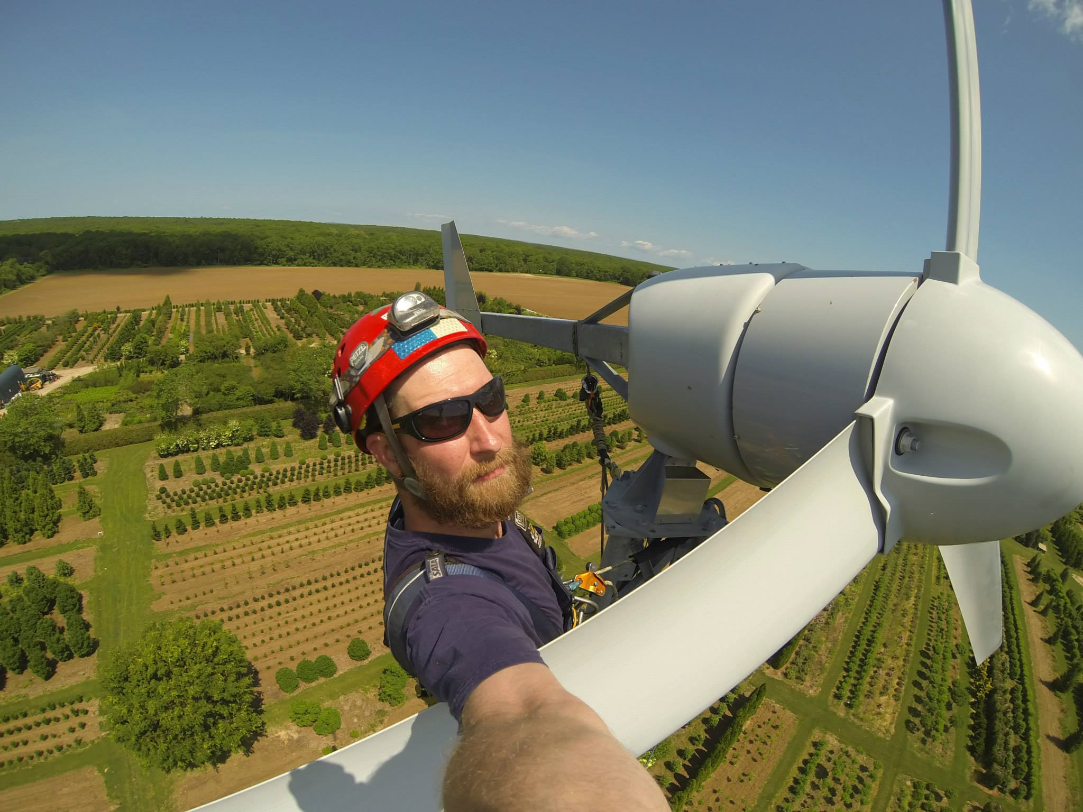
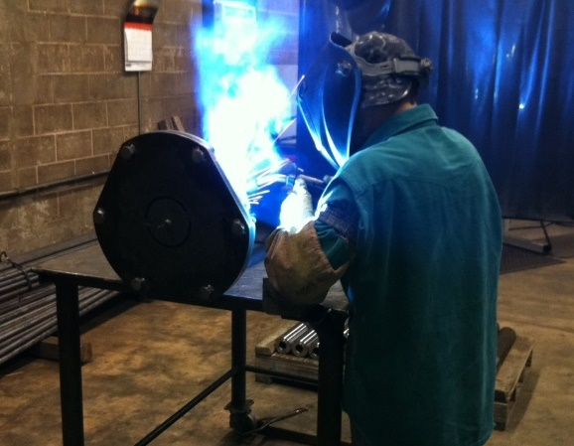
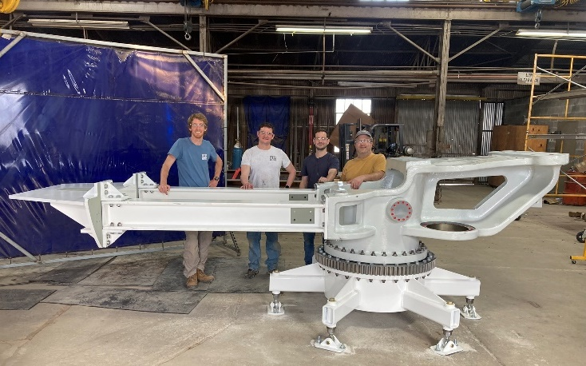
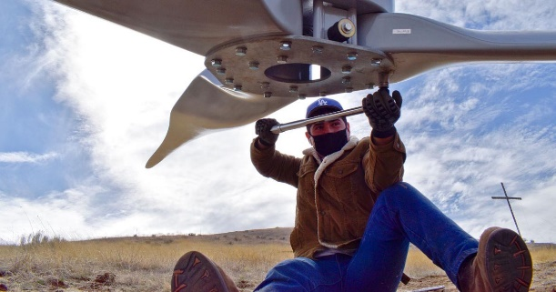
Distributed Wind, with Less Automation, is a “Jobs Machine”

Slide 8
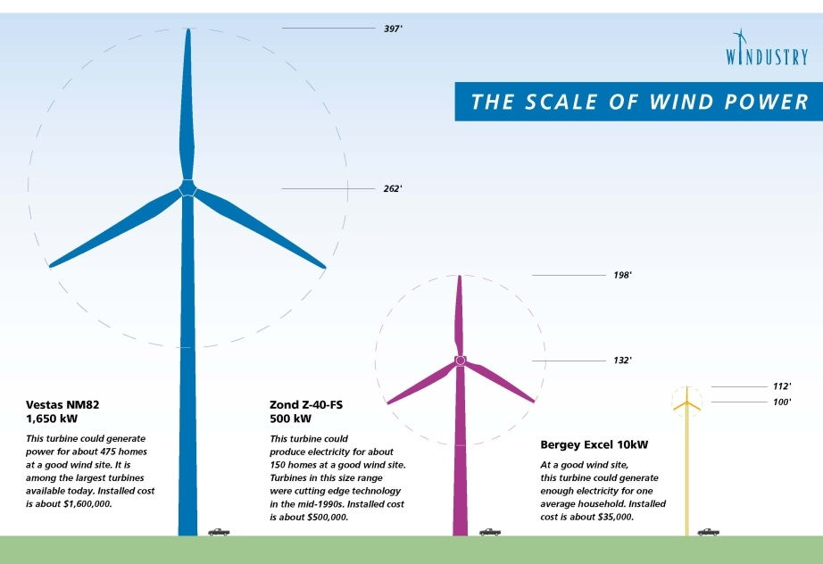

Slide 9
Turbine Size Classifications
Small: 0 – 100 kW
  Manufacturers: Bergey, Eocycle, Northern Power, Ryse, Kodair, Pecos, QED, Xflow, Primo, Sonsight, SD Wind
Mid-Size: 101 – 1,000 kW
    Manufacturers: Siva, Carter, Leitwind, EWT
Large: > 1,000 kW (> 1MW)
  Manufacturers: GE, Vestas, Siemens

Slide 10

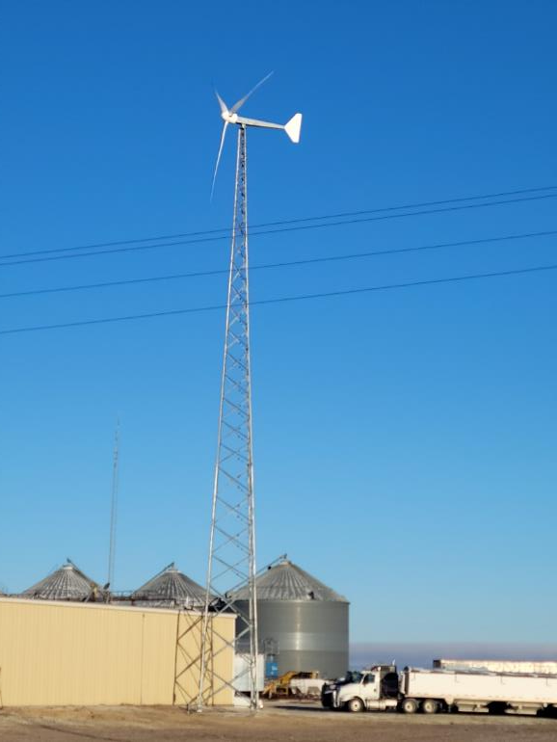
FTS Enterprises
Juniata, NE
Installed by:
  15 kW turbine on 100’ tower
  Installed March 2022
  Produces ~ 35,000 kWh per year
  $100,000 installed; USDA grant + Tax Credit + Bonus Depreciation = 3 year payback

Slide 11

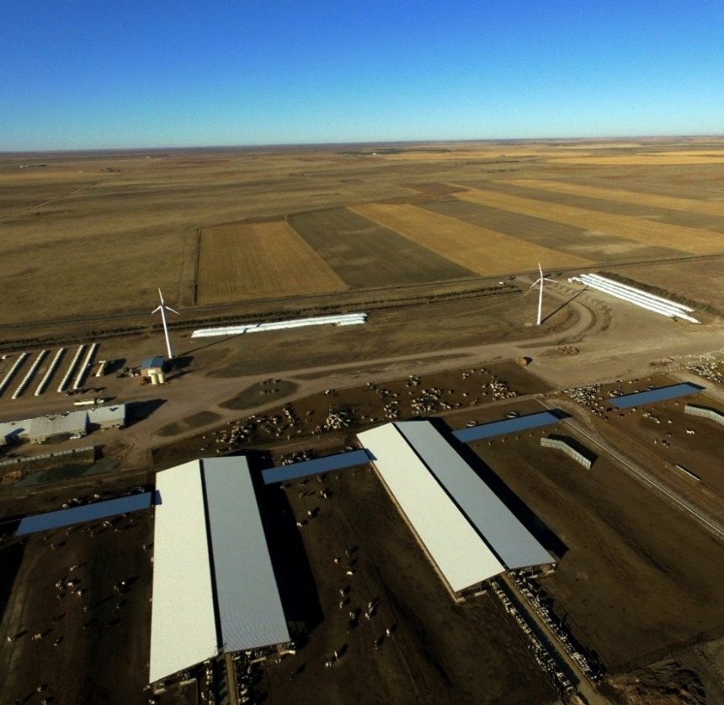
Heritage Dairy Farm
Yuma, CO
Installed by:
  2 x 100 kW turbines on 100’ towers
  Installed October 2016
  Turbines produce 480,000 kWh/yr – 60% of dairies’ annual energy
  Utility: Y-W Electric Association (REC)

Slide 12

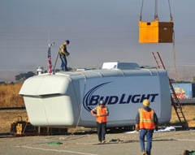
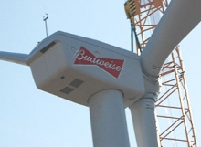
Anhueser-Busch Brewery
Fairfield, CA
Installed by:
  1,850 kW turbine, “Bud Light”, on 260’ tower installed August 2014
  Brewery’s second turbine: 1,500 kW turbine installed in 2011
  Two turbines provide 30% of energy demand (equal to 33,000 cases of beer per day)
  Installed under Power Purchase Agreement (PPA)

Slide 13
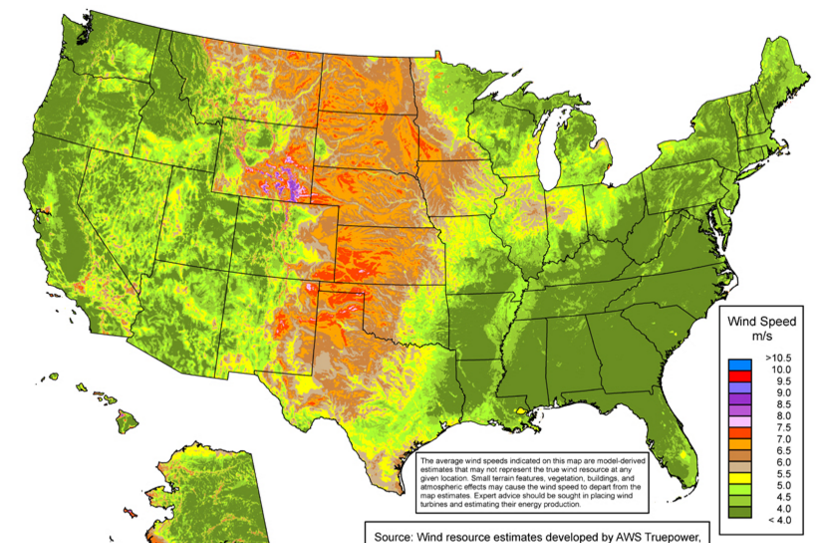
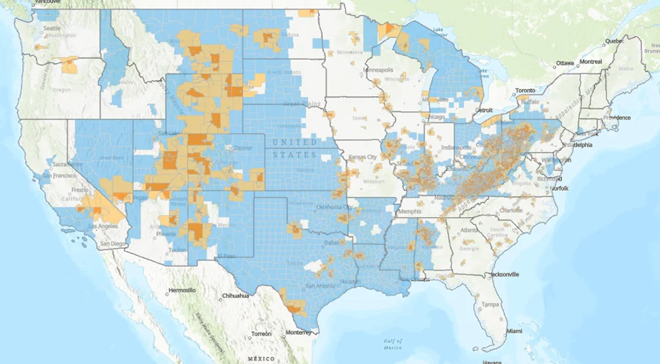
DW Potential: Comparable and Complementary to Offshore Wind
U.S. Wind Resources
Energy Communities Map, April 2023
2016 & 2022 NREL Reports:
Technical feasibility: 49.5 million residential, commercial, industrial and public sites
Economic feasibility in 2022: 1,400 GW
Economic feasibility in 2035: 6,000 GW
Offshore Wind serves larger coastal communities. Distributed Wind serves smaller interior, transitional and more disadvantaged communities. Both have large supply chain opportunities, but DW is far less developed.

Slide 14
2035 DW Potential: 1,000 GW
DWEA 2035 DW Goal: 35 GW

Slide 15
Major Cost Reduction Potential
Source: DWEA Vision Report, 2016
LCOE: Levelized Cost of Energy

Slide 16
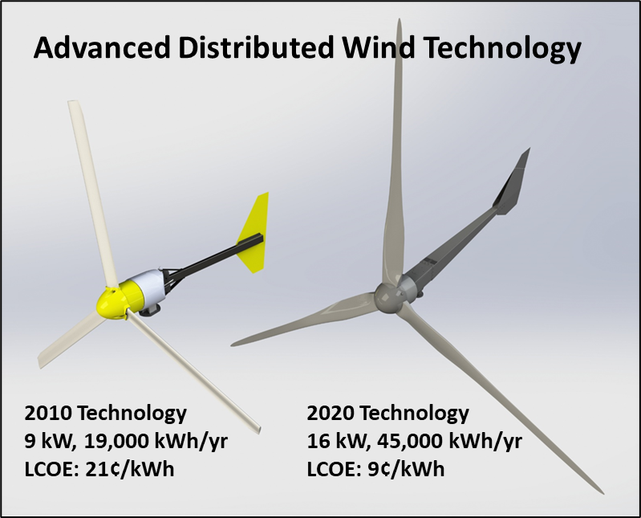

Slide 17
Federal Policies Supporting Distributed Wind
30% Investment Tax Credits for Residences (through 2032)
30% Investment Tax Credits for Businesses & Non-Profits (lower requirements for projects under 1 MW) through 2032
  10% Bonus for Domestic Content
  10% Bonus for being in an Energy Community zone (mapped annually)
  Transferability for For-Profits
  Elective Pay (rebate) for Non-Profits
1 (Sec. 179) or 5-Year depreciation for businesses
Manufacturing Tax Credits for Domestic Production, with limited Direct Pay
USDA REAP Grants up to 50% for Ag Sector and Rural Small Businesses
  “Underutilized Technologies” set-aside for wind projects

Slide 18
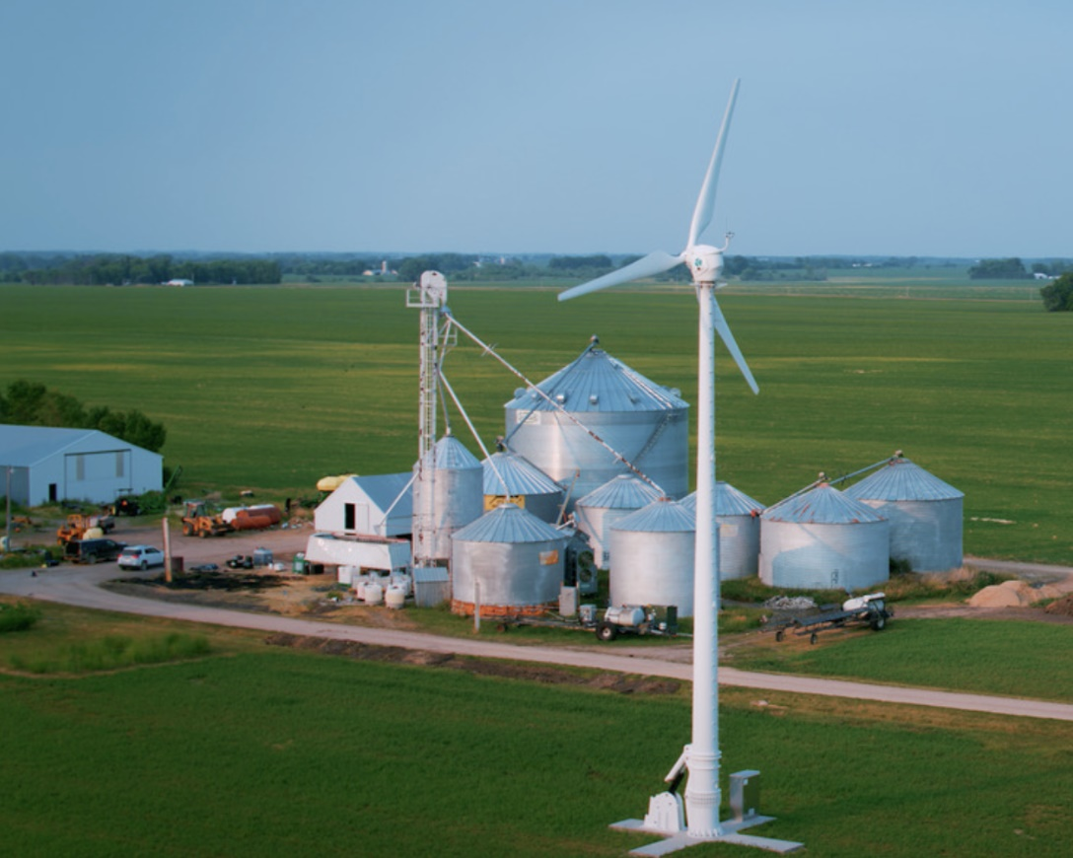
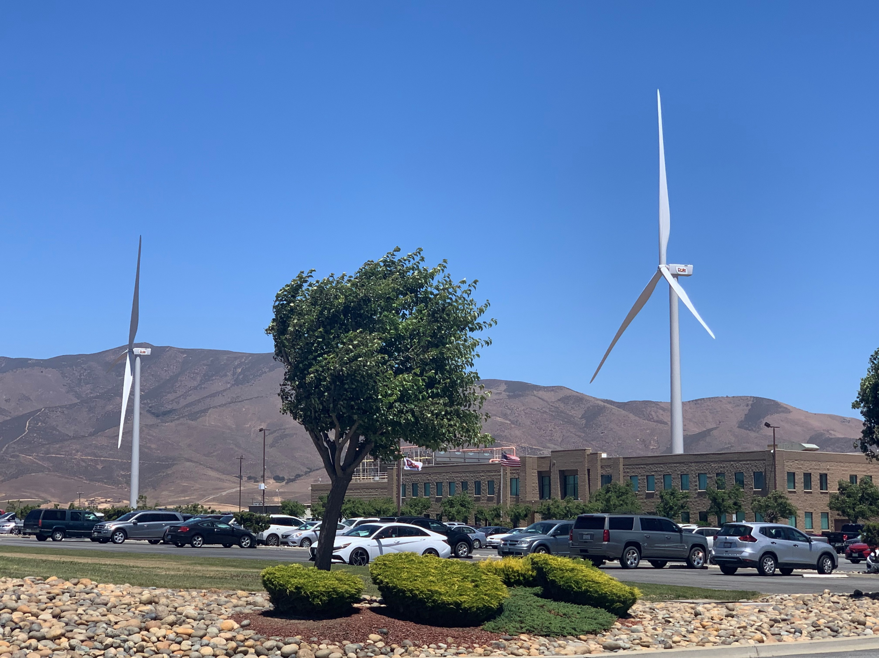
For further information, please contact DWEA at info@distributedwind.org

